Slide 1
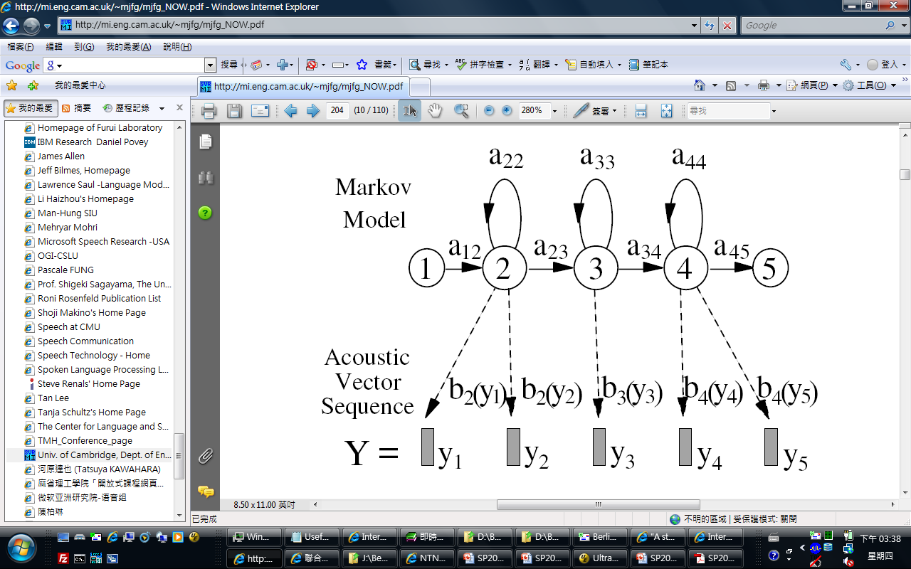

Hidden Markov Models for Speech Recognition
Berlin Chen
Department of Computer Science & Information Engineering
National Taiwan Normal University
References:
1. Rabiner and Juang. Fundamentals of Speech Recognition. Chapter 6
2. Huang et. al. Spoken Language Processing. Chapters 4, 8
3. Rabiner. A Tutorial on Hidden Markov Models and Selected Applications in Speech Recognition. Proceedings of the IEEE,
vol. 77, No. 2, February 1989
4. Gales and Young. The Application of Hidden Markov Models in Speech Recognition, Chapters 1-2, 2008
5. Young. HMMs and Related Speech Recognition Technologies. Chapter 27, Springer Handbook of Speech Processing,
Springer, 2007
6. J.A. Bilmes , A Gentle Tutorial of the EM Algorithm and its Application to Parameter Estimation for Gaussian Mixture and
Hidden Markov Models, U.C. Berkeley TR-97-021
Notes:
It is worth mentioning that Hidden Markov Models (HMMs) dominate the area of speech recognition for acoustic modeling.
HMM also has been applied to other domains with good empirical success.

Slide 2
Hidden Markov Model (HMM):
A Brief Overview
  History
  Published in papers of Baum in late 1960s and early 1970s
  Introduced to speech processing by Baker (CMU) and Jelinek (IBM) in the 1970s (discrete HMMs)
  Then extended to continuous HMMs by Bell Labs
  Assumptions
  Speech signal can be characterized as a parametric random (stochastic) process
  Parameters can be estimated in a precise, well-defined manner
  Three fundamental problems
  Evaluation of probability (likelihood) of a sequence of observations given (conditioned on) a specific HMM
  Determination of a best sequence of model states
  Adjustment of model parameters so as to best account for observed signals (or discrimination purposes)
Notes:
Papers about HMM were first published by statisticians (Baum) in late 1960s and early 1970s
Frederick Jelinek passed away on 14th September, 2010. (He was a giant of the speech and language processing society)
James K. Baker was advised by Prof. Raj Reddy at CMU

Slide 3
Stochastic Process
A stochastic process is a mathematical model of a probabilistic experiment that evolves in time and generates a sequence of numeric values
  Each numeric value in the sequence is modeled by a random variable
  A stochastic process is just a (finite/infinite) sequence of random variables
Examples
  (a) The sequence of recorded values of a speech utterance
  (b) The sequence of daily prices of a stock
  (c) The sequence of hourly traffic loads at a node of a communication network
  (d) The sequence of radar measurements of the position of an airplane

Slide 4
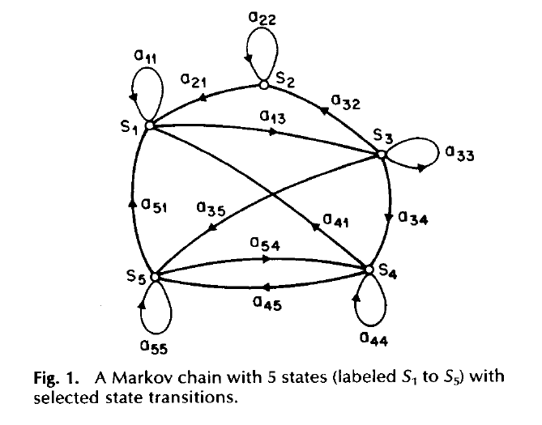
Observable Markov Model
Observable Markov Model (Markov Chain)
  First-order Markov chain of N states is a triple (S,A,π)
    S is a set of N states
    A is the NN matrix of transition probabilities between states
    P(s_{t}=j|s_{t-1}=i, s_{t-2}=k, ……) ≈ P(s_{t}=j|s_{t-1}=i) ≈ A_{ij}
    π is the vector of initial state probabilities
    π_{j} =P(s₁=j)
  The output of the process is the set of
  states at each instant of time,
  when each state corresponds to an
  observable event
  The output in any given state is
  not random (deterministic!)
  Too simple to describe the speech
  signal characteristics
First-order and time-invariant assumptions
Notes:
A Markov chain is a discrete-state Markov sequence.
If the state transition probabilities are independent of time=> a homogenous Markov chain.

Slide 5
Observable Markov Model (cont.)
First-order Markov chain of 2 states
S₁
S₂
(Prev. State, Cur. State)
S₁ S₁
S₁ S₂
Second-order Markov chain of 2 states
S₂ S₁
S₂S₂

Slide 6
Observable Markov Model (cont.)
Example 1: A 3-state Markov Chain λ
  State 1 generates symbol A only,
  State 2 generates symbol B only,
  and State 3 generates symbol C only
  Given a sequence of observed symbols O={CABBCABC}, the only one corresponding state sequence is {S₃S₁S₂S₂S₃S₁S₂S₃}, and the corresponding probability is
  P(O|λ)
  =P(S₃)P(S₁|S₃)P(S₂|S₁)P(S₂|S₂)P(S₃|S₂)P(S₁|S₃)P(S₂|S₁)P(S₃|S₂)
  =0.10.30.30.70.20.30.30.2=0.00002268
0.6
s₁
A
0.3
0.3
0.1
0.1
0.7
s₂
0.2
s₃
0.5
0.2
B
C
Notes:
Given an observation sequence, we would like to know the probability that it is generated by the Markov model. This actually corresponds to
the probability of the state sequence.

Slide 7
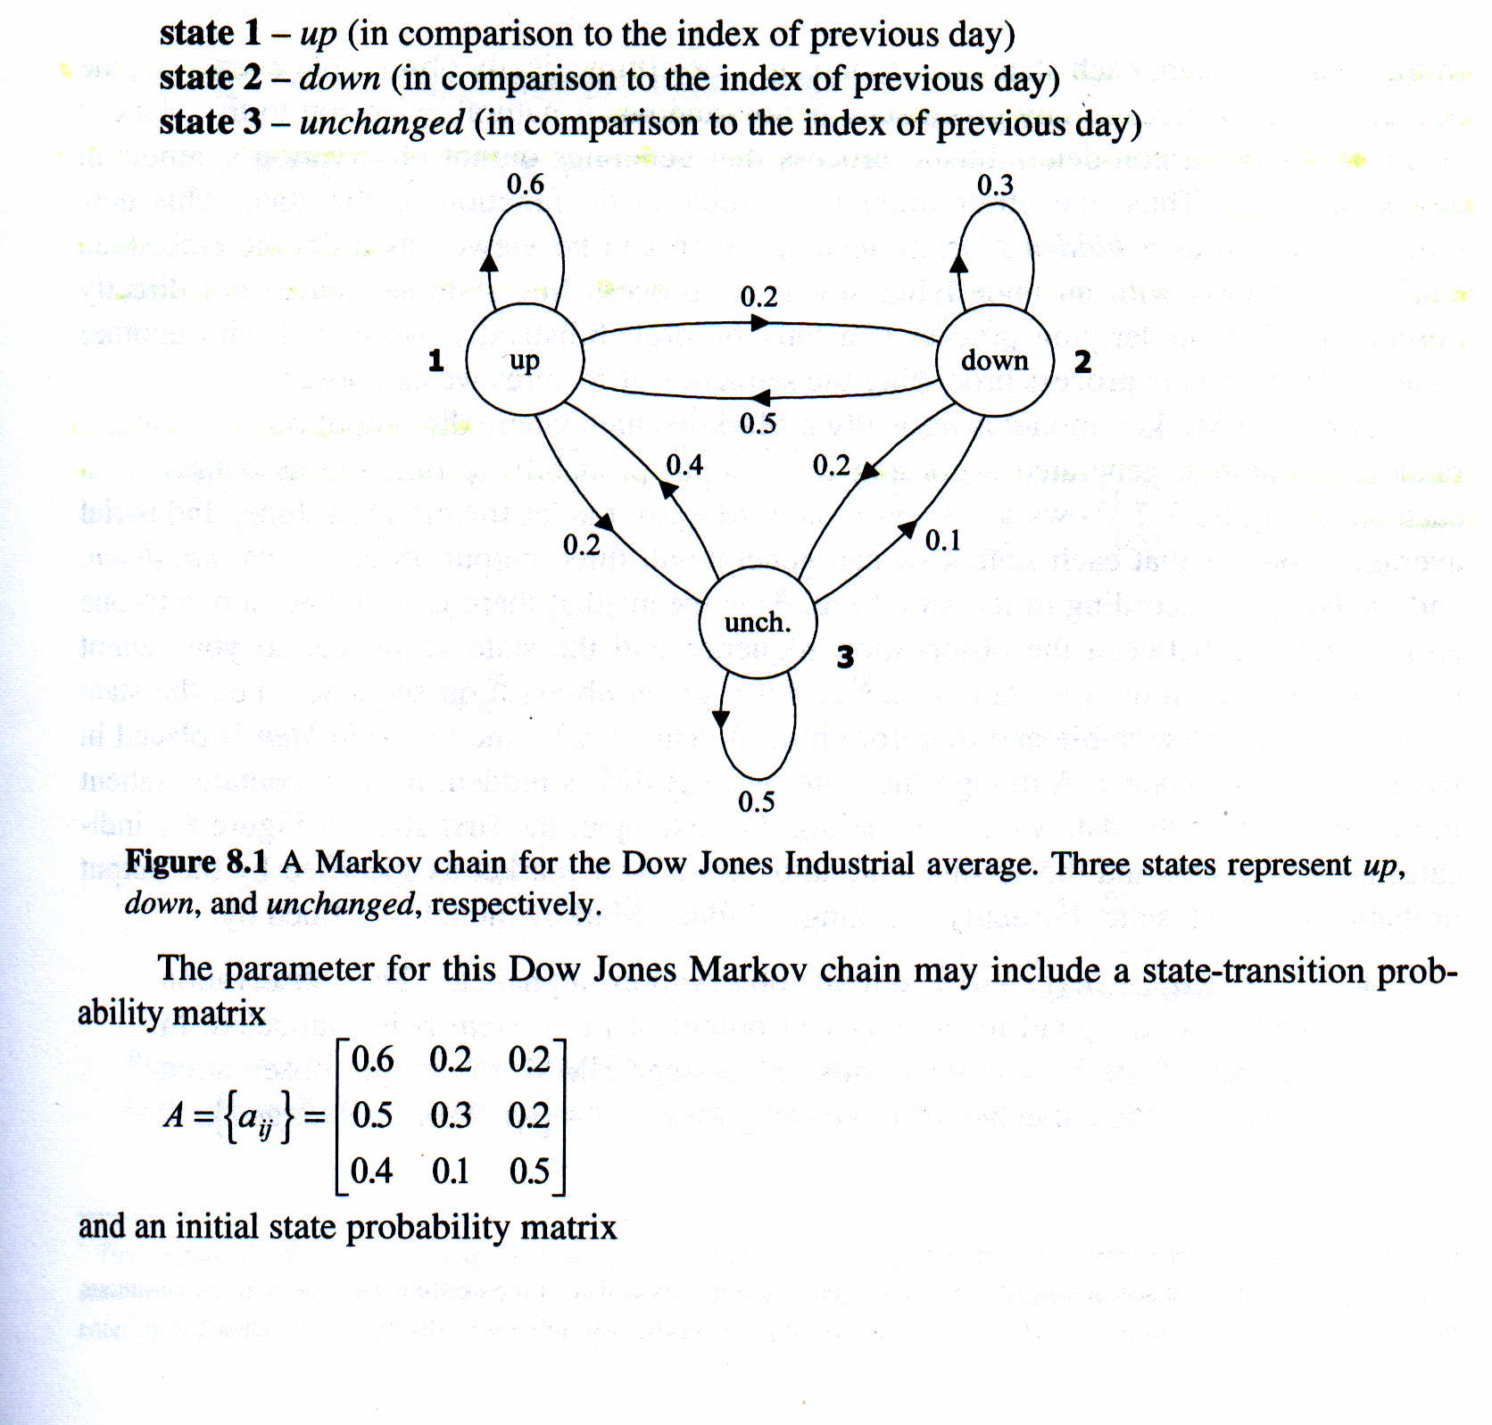
Observable Markov Model (cont.)
Example 2: A three-state Markov chain for the Dow Jones Industrial average
The probability of 5 consecutive up days
Notes:
successive

Slide 8
Observable Markov Model (cont.)
Example 3: Given a Markov model, what is the mean occupancy duration of each state i
a geometric distribution
Probability
Time (Duration)
Notes:
Derivative
View as a differentiate of ...

Slide 9
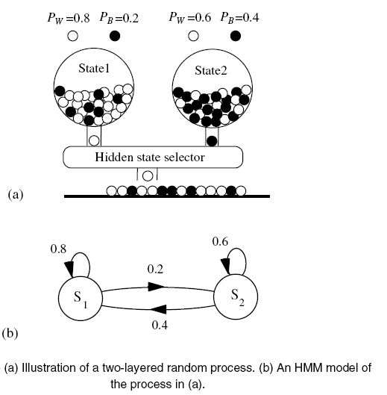
Hidden Markov Model

Slide 10
Hidden Markov Model (cont.)
HMM is an extended version of Observable Markov Model
  The observation is turned to be a probabilistic function (discrete or continuous) of a state instead of an one-to-one correspondence of a state
  The model is a doubly embedded stochastic process with an underlying stochastic process that is not directly observable (hidden)
    What is hidden? The State Sequence!
    According to the observation sequence, we are not sure which state sequence generates it!
Elements of an HMM (the State-Output HMM) λ={S,A,B,π}
  S is a set of N states
  A is the NN matrix of transition probabilities between states
  B is a set of N probability functions, each describing the observation probability with respect to a state
  π is the vector of initial state probabilities

Slide 11
Hidden Markov Model (cont.)
Two major assumptions
  First order (Markov) assumption
    The state transition depends only on the origin and destination
    Time-invariant (=> homogeneous Markov chain)
  Output-independent assumption
    All observations are dependent on the state that generated them, not on neighboring observations

Slide 12
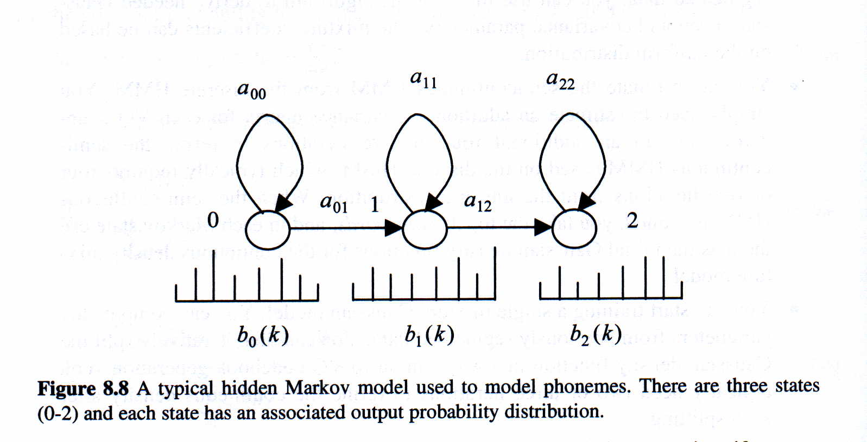
Hidden Markov Model (cont.)
Two major types of HMMs according to the observations
  Discrete and finite observations:
    The observations that all distinct states generate are finite in number
    V={v₁, v₂, v₃, ……, v_{M}}, v_{k}∈R^{L}
    In this case, the set of observation probability distributions B={b_{j}(v_{k})}, is defined as b_{j}(v_{k})=P(o_{t}=v_{k}|s_{t}=j), 1≤k≤M, 1≤j≤N
    o_{t} : observation at time t, s_{t} : state at time t
    ⇨ for state j, b_{j}(v_{k}) consists of only M probability values
A left-to-right HMM
probability mass functions
(pmfs)

Slide 13
Hidden Markov Model (cont.)
Two major types of HMMs according to the observations
  Continuous and infinite observations:
    The observations that all distinct states generate are infinite and continuous, that is, V={v| v∈R^{d}}
    In this case, the set of observation probability distributions B={b_{j}(v)}, is defined as b_{j}(v)=f_{O|S}(o_{t}=v|s_{t}=j), 1≤j≤N
    ⇨ b_{j}(v) is a continuous probability density function (pdf) and is often a mixture of Multivariate Gaussian (Normal) Distributions
Mean Vector
Mixture
Weight
Covariance
Matrix
Observation Vector
Notes:
Determinant of a matrix: characterize the spread of a random variable

Slide 14
Hidden Markov Model (cont.)
Multivariate Gaussian Distributions
  When X=(x₁, x₂,…, x_{d}) is a d-dimensional random vector, the multivariate Gaussian pdf has the form:
  If x₁, x₂,…, x_{d} are independent, the covariance matrix is reduced to diagonal covariance
    Viewed as d independent scalar Gaussian distributions
    Model complexity is significantly reduced

Slide 15
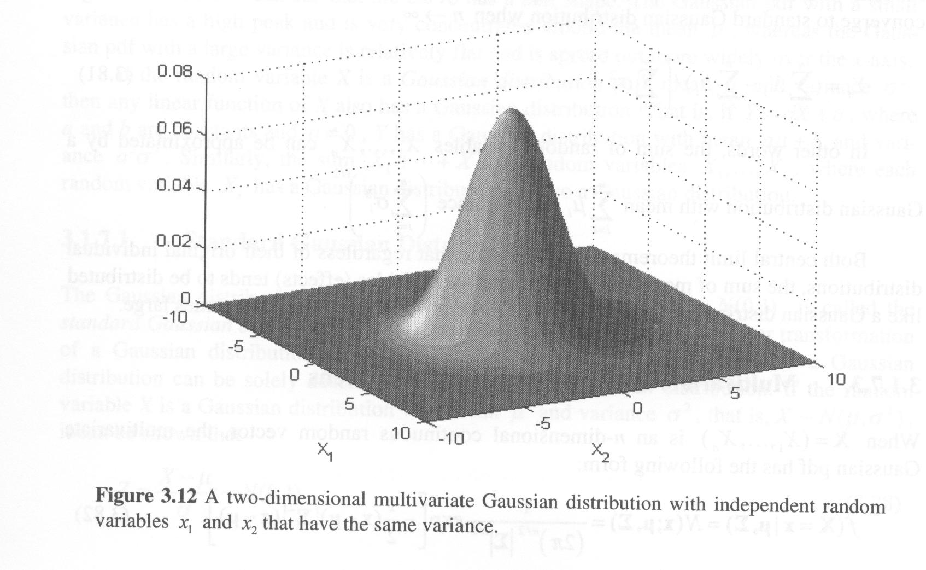
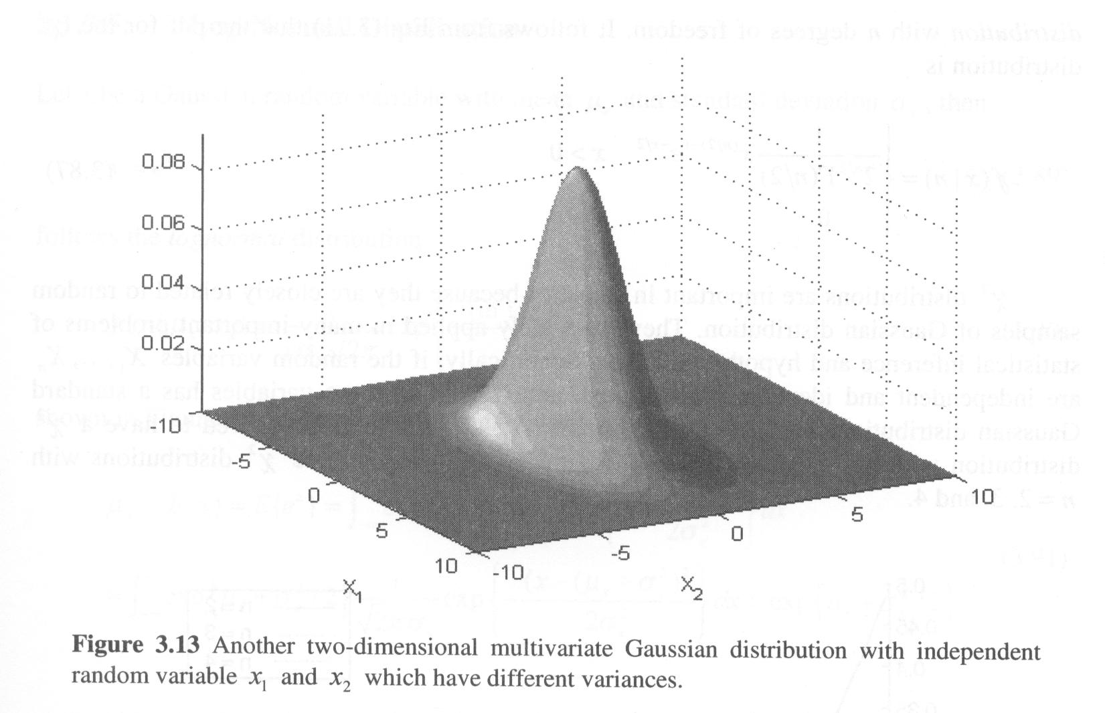
Hidden Markov Model (cont.)
Multivariate Gaussian Distributions

Slide 16
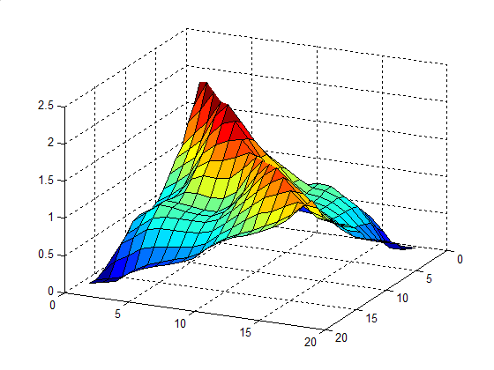
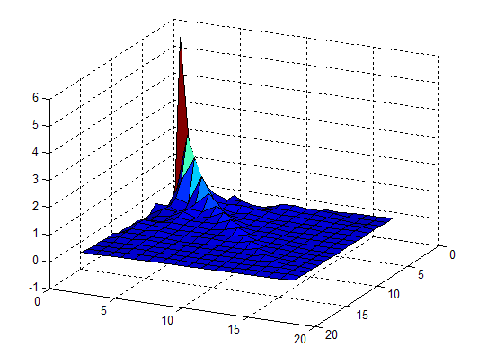
Hidden Markov Model (cont.)
Covariance matrix of the correlated feature vectors (Mel-frequency filter bank outputs)
Covariance matrix of the partially de-correlated feature vectors (MFCC without C₀)
  MFCC: Mel-frequency cepstral coefficients

Slide 17


Hidden Markov Model (cont.)
Multivariate Mixture Gaussian Distributions (cont.)
  More complex distributions with multiple local maxima (modes) can be approximated by Gaussian (a unimodal distribution) mixtures
  Gaussian mixtures with enough mixture components can approximate any distribution

Slide 18
Hidden Markov Model (cont.)
Example 4: a 3-state discrete HMM λ
  Given a sequence of observations O={ABC}, there are 27 possible corresponding state sequences, and therefore the corresponding probability is
0.6
Ergodic HMM
s₁
{A:.3,B:.2,C:.5}
0.3
0.3
0.1
0.1
0.7
s₂
0.2
s₃
0.5
0.2
{A:.7,B:.1,C:.2}
{A:.3,B:.6,C:.1}
Notes:
Ergodic HMM: allow unstrained state transition, none of the elements in the transition probability matrix is constrained to be zero

Slide 19
Hidden Markov Model (cont.)
Notations:
  O={o₁o₂o₃……o_{T}}: the observation (feature) sequence
  S= {s₁s₂s₃……s_{T}} : the state sequence
  λ : model, for HMM, λ={A,B,π}
  P(O|λ) : The probability of observing O given the model λ
  P(O|S,λ) : The probability of observing O given λ and a state sequence S of λ
  P(O,S|λ) : The probability of observing O and S given λ
  P(S|O,λ) : The probability of observing S given O and λ
Useful formulas
  Bayes’ Rule :
chain rule

Slide 20
Hidden Markov Model (cont.)
Useful formulas (Cont.):
  Total Probability Theorem
marginal probability
B₂
B₃
A
B₄
B₁
B₅
Venn Diagram
Expectation

Slide 21
Three Basic Problems for HMM
Given an observation sequence O=(o₁,o₂,…..,o_{T}),
and an HMM λ=(S,A,B,π)
  Problem 1:
  How to efficiently compute P(O|λ) ?
  ⇨ Evaluation problem
  Problem 2:
  How to choose an optimal state sequence S=(s₁,s₂,……, s_{T}) ?
  ⇨ Decoding Problem
  Problem 3:
  How to adjust the model parameter λ=(A,B,π) to maximize P(O|λ)?
  ⇨ Learning / Training Problem

Slide 22
Basic Problem 1 of HMM (cont.)
Given O and λ, find P(O|λ)= Prob[observing O given λ]
Direct Evaluation
  Evaluating all possible state sequences of length T that generating observation sequence O
  : The probability of each path S
    By Markov assumption (First-order HMM)
By chain rule
By Markov assumption

Slide 23
Basic Problem 1 of HMM (cont.)
Direct Evaluation (cont.)
  : The joint output probability along the path S
    By output-independent assumption
      The probability that a particular observation symbol/vector is emitted at time t depends only on the state s_{t} and is conditionally independent of the past observations
By output-independent assumption

Slide 24
Basic Problem 1 of HMM (cont.)
Direct Evaluation (Cont.)
  Huge Computation Requirements: O(N^{T})
    Exponential computational complexity
A more efficient algorithms can be used to evaluate
  Forward/Backward Procedure/Algorithm

Slide 25
Basic Problem 1 of HMM (cont.)
s₁
Direct Evaluation (Cont.)
s₂
s₃
State-time Trellis Diagram
State
s₃
s₃
s₃
s₃
s₃
s₂
s₂
s₂
s₂
s₂
s₁
s₁
s₁
s₁
s₁
1 2 3 T-1 T Time
O₁
O₂
O₃
O_{T-1}
O_{T}
s_{i}
denotes that b_{j}(o_{t}) has been computed
a_{ij}
denotes that a_{ij} has been computed

Slide 26
Basic Problem 1 of HMM
- The Forward Procedure
Based on the HMM assumptions, the calculation of
and involves only , and , so it is possible to compute the likelihood with recursion on
Forward variable :
  The probability that the HMM is in state i at time t having generating partial observation o₁o₂…o_{t}

Slide 27
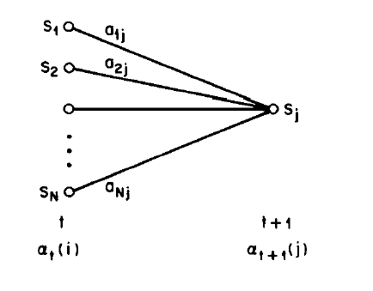
Basic Problem 1 of HMM
- The Forward Procedure (cont.)
Algorithm
  Complexity: O(N²T)
Based on the lattice (trellis) structure
  Computed in a time-synchronous fashion from left-to-right, where each cell for time t is completely computed before proceeding to time t+1
All state sequences, regardless how long previously, merge to N nodes (states) at each time instance t

Slide 28
Basic Problem 1 of HMM
- The Forward Procedure (cont.)
output
independent
assumption
first-order
Markov
assumption

Slide 29
Basic Problem 1 of HMM
- The Forward Procedure (cont.)
s₁
α₃(3)=P(o₁,o₂,o₃,s₃=3|λ)
=[α₂(1)*a₁₃+ α₂(2)*a₂₃ +α₂(3)*a₃₃]b₃(o₃)
s₂
s₃
State
s₃
s₃
s₃
s₃
s₃
s₂
s₂
s₂
s₂
s₂
s₁
s₁
s₁
s₁
s₁
1 2 3 T-1 T Time
O₁
O₂
O₃
O_{T-1}
O_{T}
s_{i}
denotes that b_{j}(o_{t}) has been computed
a_{ij}
denotes a_{ij} has been computed

Slide 30
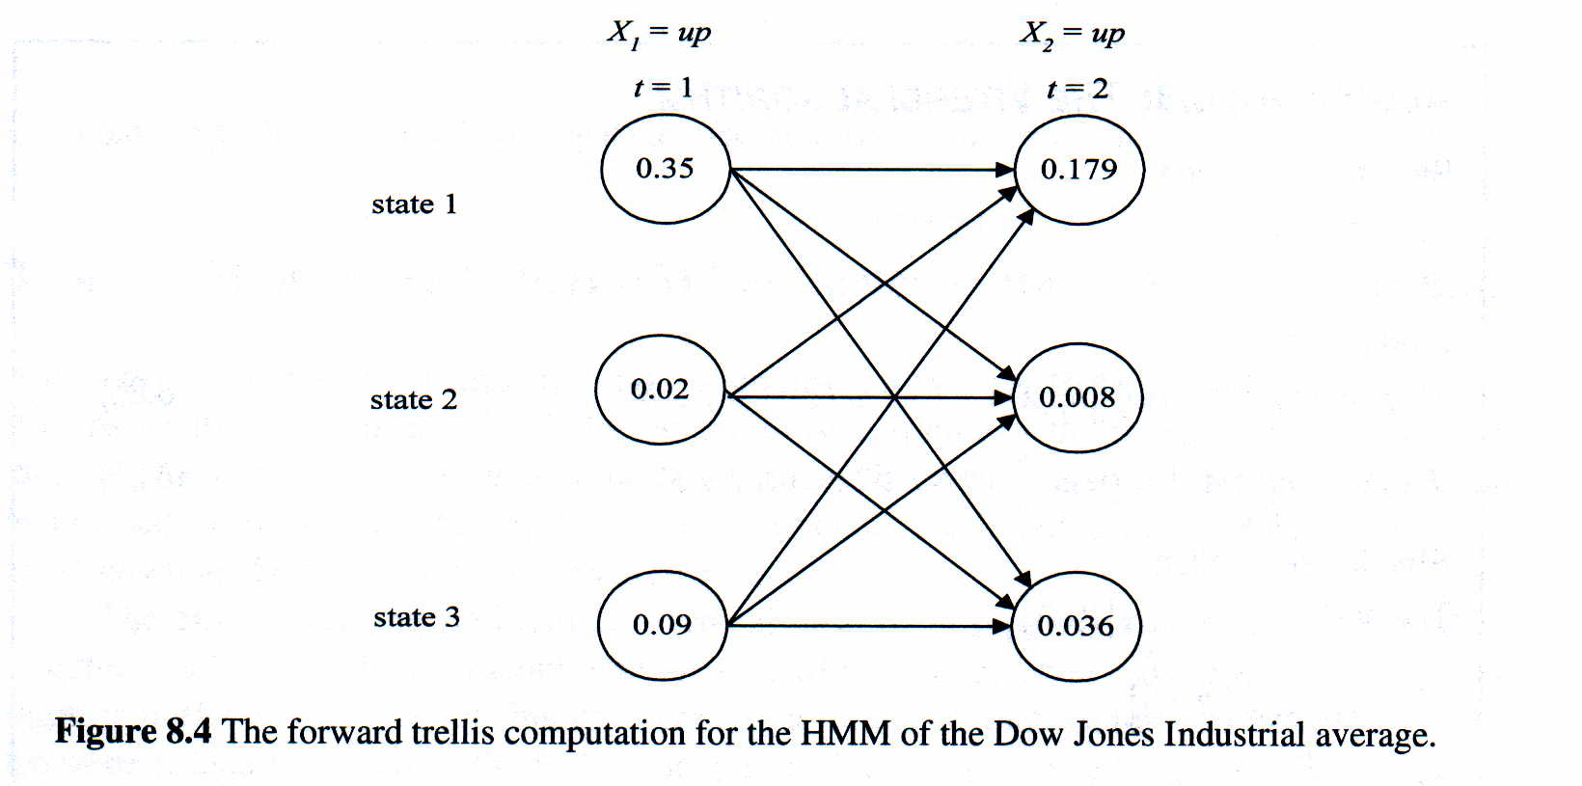
Basic Problem 1 of HMM
- The Forward Procedure (cont.)
A three-state Hidden Markov Model for the Dow Jones Industrial average
0.6
(0.6*0.35+0.5*0.02+0.4*0.009)*0.7
=0.1792
0.5
0.7
0.4
0.1
0.3

Slide 31
Basic Problem 1 of HMM
- The Backward Procedure
Backward variable : β_{t}(i)=P(o_{t+1},o_{t+2},…..,o_{T}|s_{t}=i , λ)

Slide 32
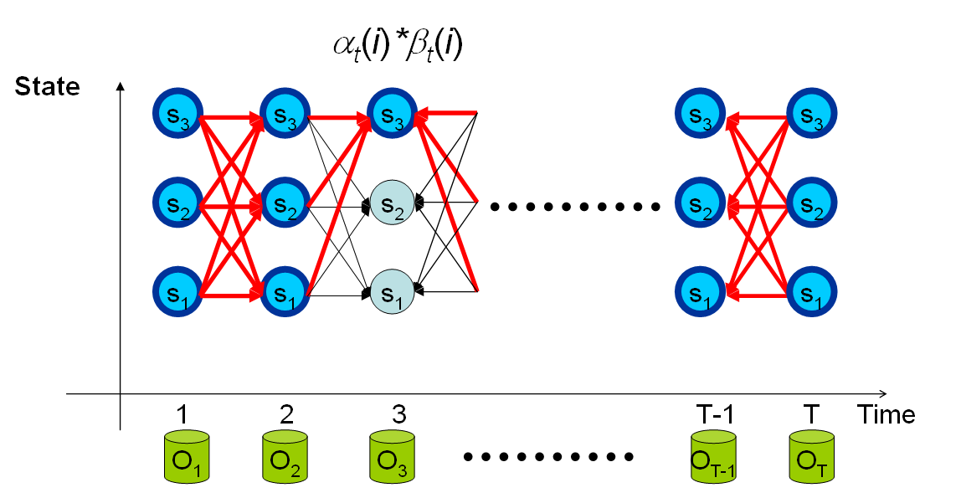
Basic Problem 1 of HMM
- Backward Procedure (cont.)
Why ?

Slide 33
Basic Problem 1 of HMM
- The Backward Procedure (cont.)
s₁
β₂(3)=P(o₃,o₄,…, o_{T}|s₂=3,λ)
=a₃₁* b₁(o₃)*β₃(1) +a₃₂* b₂(o₃)*β₃(2)+a₃₃* b₁(o₃)*β₃(3)
s₂
s₃
State
s₃
s₃
s₃
s₃
s₃
s₃
s₂
s₂
s₂
s₂
s₂
s₂
s₁
s₁
s₁
s₁
s₃
s₁
1 2 3 T-1 T Time
O₁
O₂
O₃
O_{T-1}
O_{T}

Slide 34
HMM is a Kind of Bayesian Network
S1
S2
S3
ST
O1
O2
O3
OT

Slide 35
Basic Problem 2 of HMM
How to choose an optimal state sequence S=(s₁,s₂,……, s_{T})?
The first optimal criterion: Choose the states s_{t} are individually most likely at each time t
Define a posteriori probability variable
  Solution : s_{t}* = arg_{i} max [γ_{t}(i)], 1 ≤ t ≤ T
    Problem: maximizing the probability at each time t individually
    S*= s₁*s₂*…s_{T}* may not be a valid sequence (e.g. a_{st*st+1*} = 0)
state occupation probability (count) – a soft alignment of HMM state to the
observation (feature)
Notes:
I had shown that we can solve Problem 1 with a computation complexity of N^2*T
However, there are many state sequences of an HMM model that can accommodate the generation of the observation sequences.

Slide 36
Basic Problem 2 of HMM (cont.)
s₁
P(s₃ = 3 ,O | λ)=α₃(3)*β₃(3)
s₂
s₃
α₃(3)
β₃(3)
State
s₃
s₃
s₁
s₁
s₁
s₁
s₁
s₃
s₃
s₃
a₂₃=0
s₂
s₂
s₂
s₂
s₂
s₂
s₂
s₂
s₂
s₂
s₃
s₁
s₃
s₃
s₃
s₃
s₃
s₃
s₃
s₃
1 2 3 T-1 T time
O₁
O₂
O₃
O_{T-1}
O_{T}

Slide 37
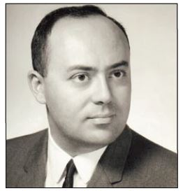
Basic Problem 2 of HMM
- The Viterbi Algorithm
Andrew James Viterbi
The second optimal criterion: The Viterbi algorithm can be regarded as the dynamic programming algorithm applied to the HMM or as a modified forward algorithm
  Instead of summing up probabilities from different paths coming to the same destination state, the Viterbi algorithm picks and remembers the best path
    Find a single optimal state sequence S=(s₁,s₂,……, s_{T})
      How to find the second, third, etc., optimal state sequences (difficult?)
  The Viterbi algorithm also can be illustrated in a trellis framework similar to the one for the forward algorithm
    State-time trellis diagram
1. R. Bellman, ”On the Theory of Dynamic Programming,” Proceedings of the National Academy of Sciences, 1952
2. A.J. Viterbi , "Error bounds for convolutional codes and an asymptotically optimum decoding algorithm,”
IEEE Transactions on Information Theory ,13 (2), 1967.
Notes:
University of Southern California Viterbi School of Engineering
安德魯·詹姆斯·維特比是一位義大利-美國電機工程師和企業家，高通公司的共同創建者之一。 維基百科

Slide 38
Basic Problem 2 of HMM
- The Viterbi Algorithm (cont.)
Algorithm
  Complexity: O(N²T)

Slide 39
Basic Problem 2 of HMM
- The Viterbi Algorithm (cont.)
s₁
s₂
s₃
δ₃(3)
State
s₃
s₃
s₃
s₃
s₃
s₂
s₂
s₂
s₂
s₂
s₁
s₁
s₁
s₁
s₁
1 2 3 T-1 T time
O₁
O₂
O₃
O_{T-1}
O_{T}

Slide 40
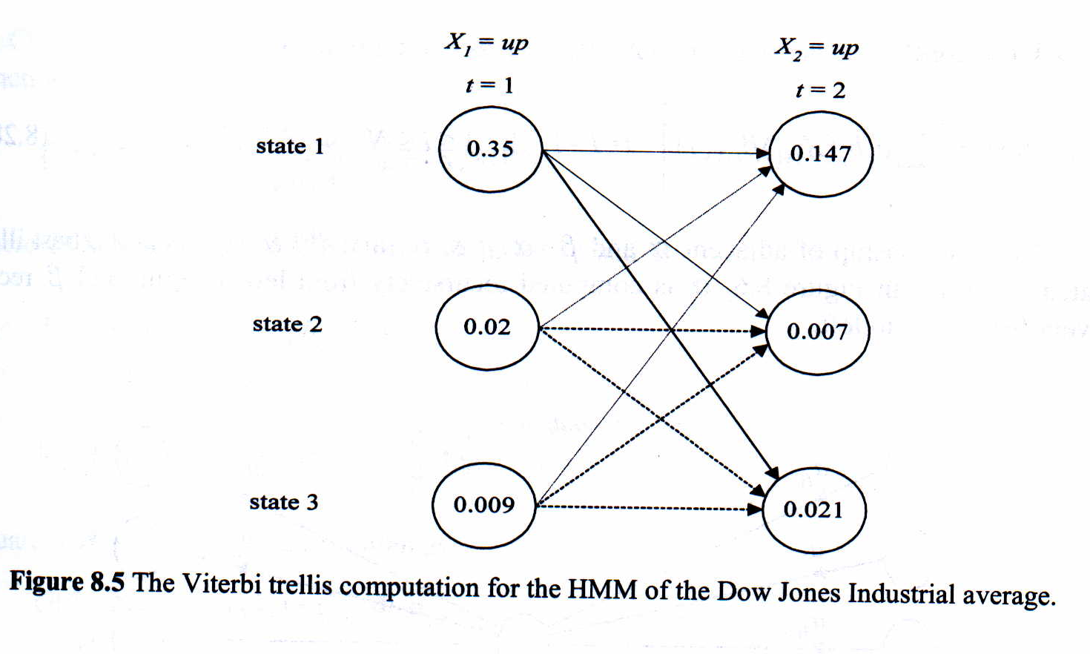
Basic Problem 2 of HMM
- The Viterbi Algorithm (cont.)
A three-state Hidden Markov Model for the Dow Jones Industrial average
0.6
(0.6*0.35)*0.7
=0.147
0.5
0.4
0.7
0.1
0.3

Slide 41
Basic Problem 2 of HMM
- The Viterbi Algorithm (cont.)
Algorithm in the logarithmic form

Slide 42
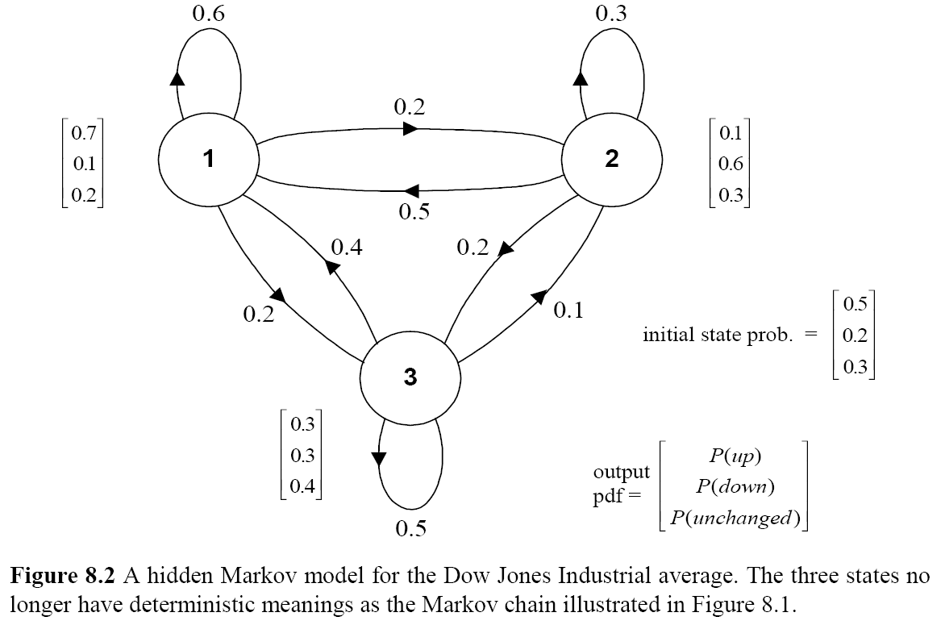
Homework 1
A three-state Hidden Markov Model for the Dow Jones Industrial average
  Find the probability:
  P(up, up, unchanged, down, unchanged, down, up|λ)
  Fnd the optimal state sequence of the model which generates the observation sequence: (up, up, unchanged, down, unchanged, down, up)

Slide 43
Probability Addition in F-B Algorithm
In Forward-backward algorithm, operations usually implemented in logarithmic domain
Assume that we want to add and
P₁
logP₁
P₁ +P₂
logP₂
log(P₁+P₂)
P₂
The values of can be
saved in in a table to speedup the operations

Slide 44
Probability Addition in F-B Algorithm (cont.)
An example code
#define LZERO (-1.0E10) // ~log(0)
#define LSMALL (-0.5E10) // log values < LSMALL are set to LZERO
#define minLogExp -log(-LZERO) // ~=-23
double LogAdd(double x, double y)
{
double temp,diff,z;
if (x<y)
{
temp = x; x = y; y = temp;
}
diff = y-x; //notice that diff <= 0
if (diff<minLogExp) // if y’ is far smaller than x’
return (x<LSMALL) ? LZERO:x;
else
{
z = exp(diff);
return x+log(1.0+z);
}
}

Slide 45
Basic Problem 3 of HMM
Intuitive View
How to adjust (re-estimate) the model parameter λ=(A,B,π) to maximize P(O1,…, OL|λ) or logP(O1,…, OL |λ)?
  Belonging to a typical problem of “inferential statistics”
  The most difficult of the three problems, because there is no known analytical method that maximizes the joint probability of the training data in a close form
  The data is incomplete because of the hidden state sequences
  Well-solved by the Baum-Welch (known as forward-backward) algorithm and EM (Expectation-Maximization) algorithm
    Iterative update and improvement
    Based on Maximum Likelihood (ML) criterion
The “log of sum” form is
difficult to deal with
Notes:
In contrast to “Descriptive Statistics”

Slide 46
Maximum Likelihood (ML) Estimation:
A Schematic Depiction (1/2)
Hard Assignment
  Given the data follow a multinomial distribution
State S₁
P(B| S₁)=2/4=0.5
P(W| S₁)=2/4=0.5

Slide 47
Maximum Likelihood (ML) Estimation:
A Schematic Depiction (1/2)
Soft Assignment
  Given the data follow a multinomial distribution
  Maximize the likelihood of the data given the alignment
State S₁
State S₂
0.7
0.3
P(B| S₁)=(0.7+0.9)/
(0.7+0.4+0.9+0.5)
=1.6/2.5=0.64
0.4
0.6
P(B| S₂)=(0.3+0.1)/
(0.3+0.6+0.1+0.5)
=0.4/1.5=0.27
0.9
0.1
P(W| S₁)=(0.4+0.5)/
(0.7+0.4+0.9+0.5)
=0.9/2.5=0.36
0.5
0.5
P(W| S₂)=( 0.6+0.5)/
(0.3+0.6+0.1+0.5)
=0.11/1.5=0.73

Slide 48
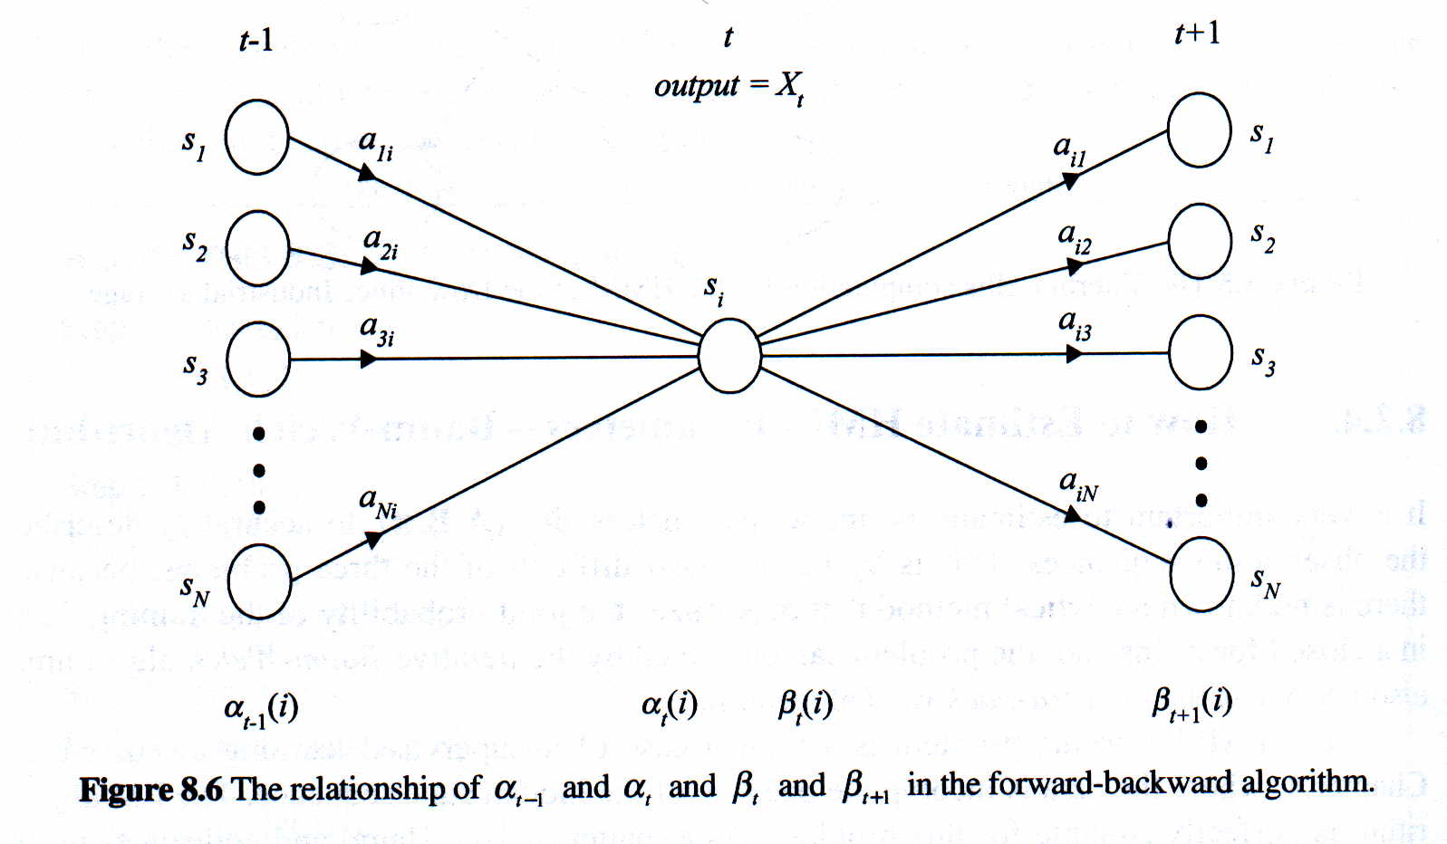
Basic Problem 3 of HMM
Intuitive View (cont.)
Relationship between the forward and backward variables

Slide 49
Basic Problem 3 of HMM
Intuitive View (cont.)
j
i
Define a new variable:
  Probability being at state i at time t and at state j at time t+1
Recall the posteriori probability variable:
t
t+1

Slide 50
Basic Problem 3 of HMM
Intuitive View (cont.)
s₁
P(s₃ = 3, s₄ = 1,O | λ)=α₃(3)*a₃₁*b₁(o₄)*β₁(4)
s₂
s₃
State
s₃
s₃
s₃
s₃
s₃
s₃
s₁
s₁
s₁
s₂
s₂
s₂
s₂
s₂
s₂
s₂
s₂
s₂
s₁
s₁
s₁
s₁
s₁
s₁
s₃
s₃
s₁
1 2 3 4 T-1 T time
O₁
O₂
O₃
O_{T-1}
O_{T}

Slide 51
Basic Problem 3 of HMM
Intuitive View (cont.)
A set of reasonable re-estimation formula for {A,π} is
Formulae for Single Training Utterance

Slide 52
Basic Problem 3 of HMM
Intuitive View (cont.)
A set of reasonable re-estimation formula for {B} is
  For discrete and finite observation b_{j}(v_{k})=P(o_{t}=v_{k}|s_{t}=j)
  For continuous and infinite observation b_{j}(v)=f_{O|S}(o_{t}=v|s_{t}=j),
Modeled as a mixture of multivariate Gaussian distributions

Slide 53
Basic Problem 3 of HMM
Intuitive View (cont.)
  For continuous and infinite observation (Cont.)
    Define a new variable
      is the probability of being in state j at time t with the k-th mixture component accounting for o_{t}
c₁₂
c₁₁
c₁₃
N₂
N₁
N₃
Distribution for State 1

Slide 54
Basic Problem 3 of HMM
Intuitive View (cont.)
  For continuous and infinite observation (Cont.)
Formulae for Single Training Utterance

Slide 55
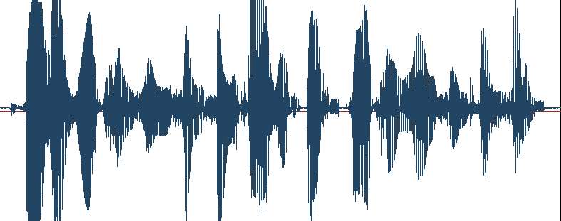
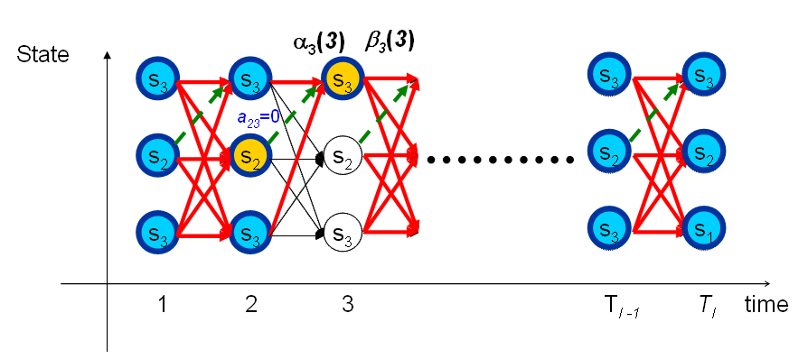
Basic Problem 3 of HMM
Intuitive View (cont.)
Multiple Training Utterances
F/B
F/B
F/B
台師大
s₁
s₂
s₃

Slide 56
Basic Problem 3 of HMM
Intuitive View (cont.)
  For continuous and infinite observation (Cont.)
Formulae for Multiple (L) Training Utterances
Notes:
Averaged over the entire data set

Slide 57
Basic Problem 3 of HMM
Intuitive View (cont.)
  For discrete and finite observation (cont.)
Formulae for Multiple (L) Training Utterances

Slide 58
Semicontinuous HMMs
The HMM state mixture density functions are tied together across all the models to form a set of shared kernels
  The semicontinuous or tied-mixture HMM
  A combination of the discrete HMM and the continuous HMM
    A combination of discrete model-dependent weight coefficients and continuous model-independent codebook probability density functions
  Because M is large, we can simply use the L most significant values
    Experience showed that L is 1~3% of M is adequate
  Partial tying of for different phonetic class
state output
Probability of state j
k-th mixture weight
t of state j
(discrete, model-dependent)
k-th mixture density function or k-th codeword
(shared across HMMs, M is very large)

Slide 59
Semicontinuous HMMs (cont.)
s₃
s₃
s₂
s₂
s₁
s₁
s₃
s₂
s₁
s₃
s₂
s₃
s₁
s₂
s₁

Slide 60
HMM Topology
Speech is time-evolving non-stationary signal
  Each HMM state has the ability to capture some quasi-stationary segment in the non-stationary speech signal
  A left-to-right topology is a natural candidate to model the speech signal (also called the “beads-on-a-string” model)
  It is general to represent a phone using 3~5 states (English) and a syllable using 6~8 states (Mandarin Chinese)

Slide 61
Initialization of HMM
s₁
s₂
s₃
A good initialization of HMM training :
Segmental K-Means Segmentation into States
  Assume that we have a training set of observations and an initial estimate of all model parameters
  Step 1 : The set of training observation sequences is segmented into states, based on the initial model (finding the optimal state sequence by Viterbi Algorithm)
  Step 2 :
    For discrete density HMM (using an M-codeword codebook)
    For continuous density HMM (M Gaussian mixtures per state)
  Step 3: Evaluate the model score
  If the difference between the previous and current model scores is greater than a threshold, go back to Step 1, otherwise stop, the initial model is generated

Slide 62
Initialization of HMM (cont.)

Slide 63
Initialization of HMM (cont.)
s₁
s₂
s₃
An example for discrete HMM
  3 states and 2 codeword
    b₁(v₁)=3/4, b₁(v₂)=1/4
    b₂(v₁)=1/3, b₂(v₂)=2/3
    b₃(v₁)=2/3, b₃(v₂)=1/3
State
s₃
s₃
s₃
s₃
s₃
s₃
s₃
s₃
s₃
s₃
s₂
s₂
s₂
s₂
s₂
s₂
s₂
s₂
s₂
s₂
s₁
s₁
s₁
s₁
s₁
s₁
s₁
s₁
s₁
s₁
1 2 3 4 5 6 7 8 9 10
O₁
O₂
O₃
O₄
O₅
O₆
O₇
O₈
O₉
O₁₀
v₁
v₂

Slide 64
Initialization of HMM (cont.)
s₁
s₂
s₃
An example for Continuous HMM
  3 states and 4 Gaussian mixtures per state
State
s₃
s₃
s₃
s₃
s₃
s₃
s₃
s₃
s₃
s₂
s₂
s₂
s₂
s₂
s₂
s₂
s₂
s₂
s₁
s₁
s₁
s₁
s₁
s₁
s₁
s₁
s₁
1 2 N
O₁
O₂
O_{N}
K-means
{μ₁₂,Σ₁₂,ω₁₂}
{μ₁₁,Σ₁₁,ω₁₁}
Global mean
Cluster 1 mean
Cluster 2mean
{μ₁₃,Σ₁₃,ω₁₃}
{μ₁₄,Σ₁₄,ω₁₄}

Slide 65
Known Limitations of HMMs (1/3)
The assumptions of conventional HMMs in Speech Processing
  The state duration follows an exponential distribution
    Don’t provide adequate representation of the temporal structure of speech
  First- order (Markov) assumption: the state transition depends only on the origin and destination
  Output-independent assumption: all observation frames are dependent on the state that generated them, not on neighboring observation frames
  Researchers have proposed a number of techniques to address these limitations, albeit these solution have not significantly improved speech recognition accuracy for practical applications.

Slide 66
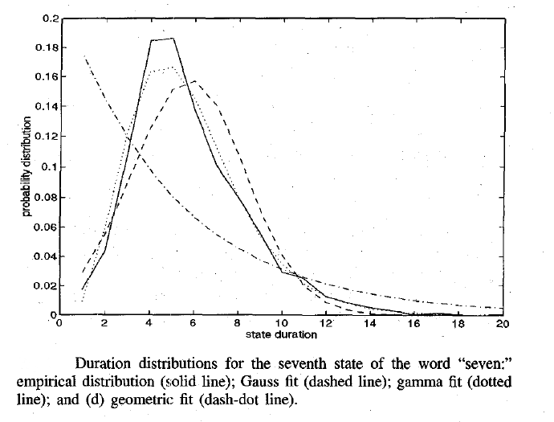
Known Limitations of HMMs (2/3)
Duration modeling
empirical distribution
geometric/
exponential
distribution
Gamma
distribution
Gaussian distribution

Slide 67
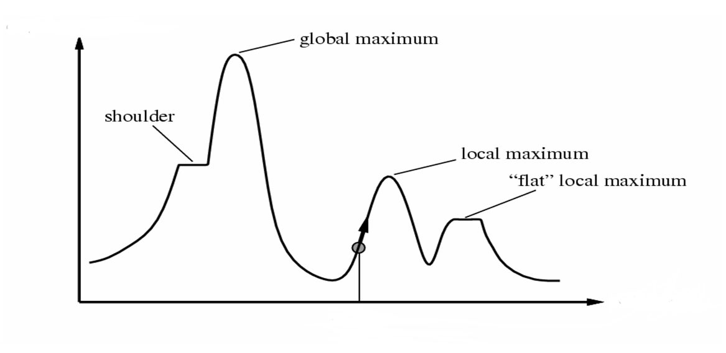
Known Limitations of HMMs (3/3)
The HMM parameters trained by the Baum-Welch algorithm (or EM algorithm) were only locally optimized
Likelihood
Current Model Configuration
Model Configuration Space

Slide 68
Homework-2 (1/2)
0.34
{A:.34,B:.33,C:.33}
s₁
0.33
0.33
0.33
0.33
0.34
s₂
0.33
s₃
0.34
0.33
{A:.33,B:.34,C:.33}
{A:.33,B:.33,C:.34}
TrainSet 1:
1. ABBCABCAABC
2. ABCABC
3. ABCA ABC
4. BBABCAB
5. BCAABCCAB
6. CACCABCA
7. CABCABCA
8. CABCA
9. CABCA
TrainSet 2:
1. BBBCCBC
2. CCBABB
3. AACCBBB
4. BBABBAC
5. CCA ABBAB
6. BBBCCBAA
7. ABBBBABA
8. CCCCC
9. BBAAA

Slide 69
Homework-2 (2/2)
P1. Please specify the model parameters after the first and 50th
iterations of Baum-Welch training
P2. Please show the recognition results by using the above training
sequences as the testing data (The so-called inside testing).
*You have to perform the recognition task with the HMMs trained
from the first and 50th iterations of Baum-Welch training, respectively
P3. Which class do the following testing sequences belong to?
ABCABCCAB
AABABCCCCBBB
P4. What are the results if Observable Markov Models were instead used in P1, P2 and P3?

Slide 70
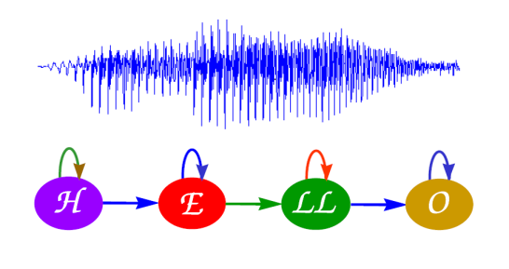
Isolated Word Recognition
Word Model M₁
Likelihood
of M₁
Word Model M₂
Likelihood
of M₂
Feature
Sequence
Speech
Signal
Feature
Extraction
X
M_{ML}
Most Like Word Selector
Word Model M_{V}
Likelihood
of M_{V}
Viterbi Approximation
Word Model M_{Sil}
Likelihood
of M_{Sil}

Slide 71
Measures of ASR Performance (1/2)
Evaluating the performance of automatic speech recognition (ASR) systems is critical, and the Word Recognition Error Rate (WER) is one of the most important measures
There are typically three types of word recognition errors
  Substitution
    An incorrect word was substituted for the correct word
  Deletion
    A correct word was omitted in the recognized sentence
  Insertion
    An extra word was added in the recognized sentence
How to determine the minimum error rate?

Slide 72
Measures of ASR Performance (2/2)
Calculate the WER by aligning the correct word string against the recognized word string
  A maximum substring matching problem
  Can be handled by dynamic programming
Example:
  Error analysis: one deletion and one insertion
  Measures: word error rate (WER), word correction rate (WCR), word accuracy rate (WAR)
deleted
Correct : “the effect is clear”
Recognized: “effect is not clear”
matched
inserted
matched
Might be higher than 100%
WER+
WAR
=100%
Might be negative

Slide 73
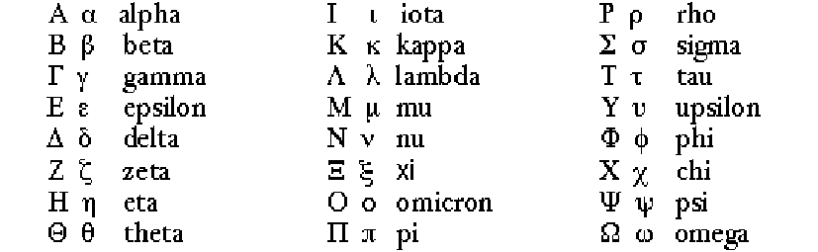
Symbols for Mathematical Operations

Slide 74
The EM Algorithm (1/7)
λ
0.6
s₁
{A:.3,B:.2,C:.5}
o₁,o₂,……,o_{T}
0.3
0.3
p(O|λ)
0.3
0.1
0.7
s₂
0.2
s₃
0.7
0.2
p(O|λ)> p(O|λ)
{A:.7,B:.1,C:.2}
{A:.3,B:.6,C:.1}
A
B
Observed data : O : “ball sequence”
Latent data : S : “bottle sequence”
Parameters to be estimated to maximize logP(O|λ)
λ={P(A),P(B),P(B|A),P(A|B),P(R|A),P(G|A),P(R|B),P(G|B)}

Slide 75
The EM Algorithm (2/7)
Introduction of EM (Expectation Maximization):
  Why EM?
    Simple optimization algorithms for likelihood function relies on the intermediate variables, called latent data
    In our case here, the state sequence is the latent data
    Direct access to the data necessary to estimate the parameters is impossible or difficult
    In our case here, it is almost impossible to estimate {A,B, π} without consideration of the state sequence
  Two Major Steps :
    E : expectation with respect to the latent data using the current estimate of the parameters and conditioned on the observations
    M: provides a new estimation of the parameters according to Maximum likelihood (ML) or Maximum A Posterior (MAP) Criteria

Slide 76
The EM Algorithm (3/7)
ML and MAP
Estimation principle based on observations:
  The Maximum Likelihood (ML) Principle
  find the model parameter so that the likelihood is maximum
  for example, if is the parameters of a multivariate normal distribution, and X is i.i.d. (independent, identically distributed), then the ML estimate of is
  The Maximum A Posteriori (MAP) Principle
  find the model parameter so that the likelihood is maximum

Slide 77
The EM Algorithm (4/7)
The EM Algorithm is important to HMMs and other learning techniques
  Discover new model parameters to maximize the log-likelihood of incomplete data by iteratively maximizing the expectation of log-likelihood from complete data
Firstly, using scalar (discrete) random variables to introduce the EM algorithm
  The observable training data
    We want to maximize , is a parameter vector
  The hidden (unobservable) data
    E.g. the component probabilities (or densities) of observable data , or the underlying state sequence in HMMs

Slide 78
The EM Algorithm (5/7)
  Assume we have and estimate the probability that each occurred in the generation of
  Pretend we had in fact observed a complete data pair with frequency proportional to the probability , to computed a new , the maximum likelihood estimate of
  Does the process converge?
  Algorithm
    Log-likelihood expression and expectation taken over S
unknown model setting
Bayes’ rule
complete data likelihood
incomplete data likelihood
take expectation over S

Slide 79
The EM Algorithm (6/7)
  Algorithm (Cont.)
    We can thus express as follows
    We want

Slide 80
The EM Algorithm (7/7)
    has the following property
  Therefore, for maximizing , we only need to maximize the Q-function (auxiliary function)
Kullbuack-Leibler (KL) distance
Jensen’s inequality
Expectation of the complete
data log likelihood with respect
to the latent state sequences

Slide 81
EM Applied to Discrete HMM Training (1/5)
Apply EM algorithm to iteratively refine the HMM parameter vector
  By maximizing the auxiliary function
  Where and can be expressed as

Slide 82
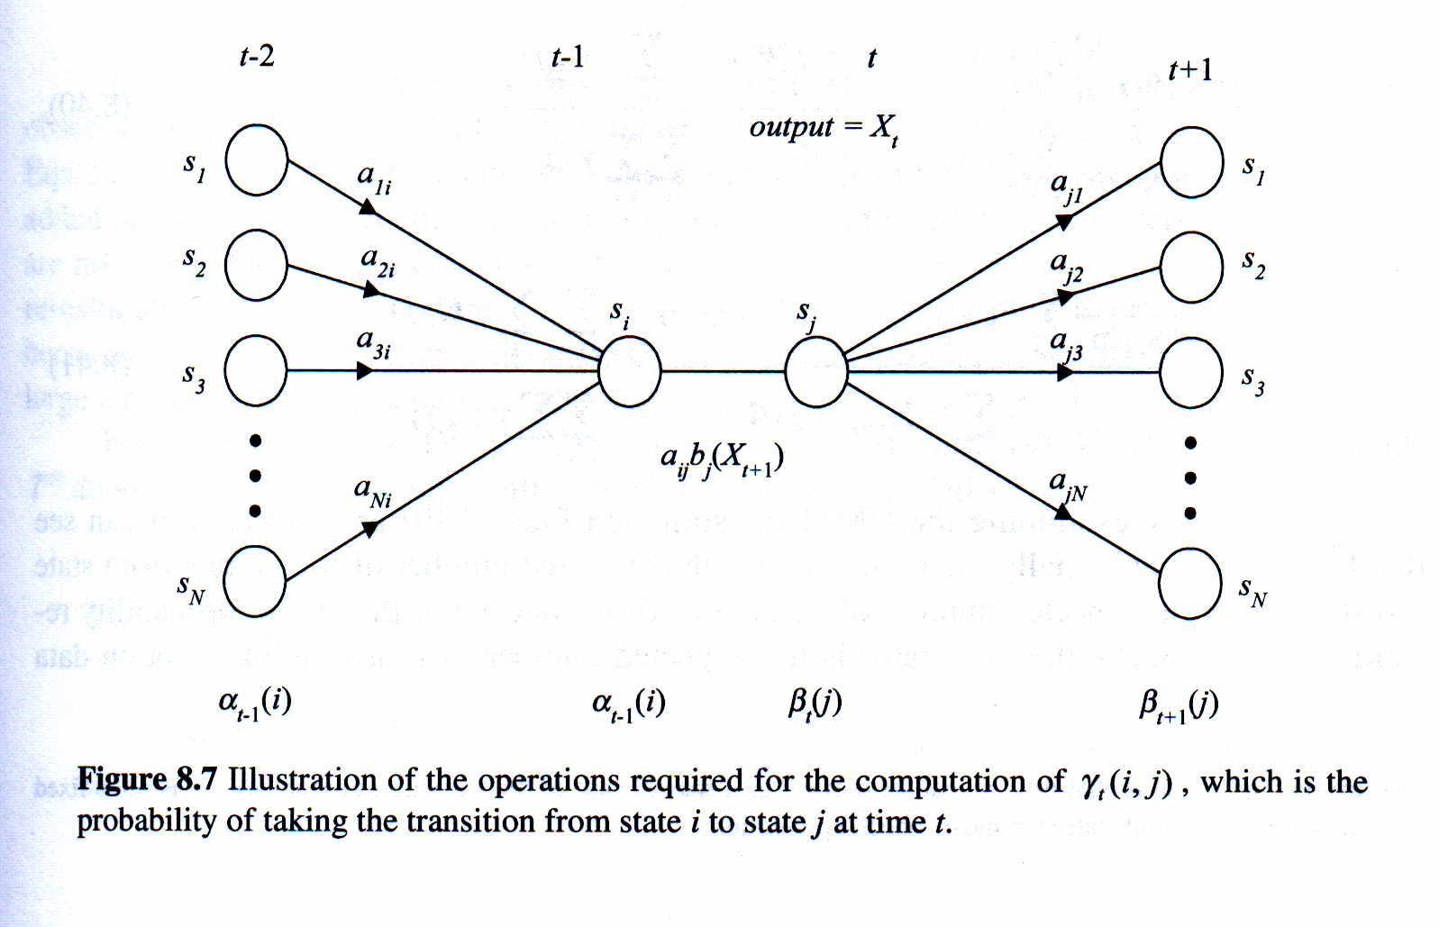
EM Applied to Discrete HMM Training (2/5)
Rewrite the auxiliary function as
w_{i}
y_{i}
?
?
?

Slide 83
EM Applied to Discrete HMM Training (3/5)
The auxiliary function contains three independent
terms, , and
  Can be maximized individually
  All of the same form

Slide 84
EM Applied to Discrete HMM Training (4/5)
Proof: Apply Lagrange Multiplier
Constraint
Lagrange Multiplier: http://www.slimy.com/~steuard/teaching/tutorials/Lagrange.html

Slide 85
EM Applied to Discrete HMM Training (5/5)
The new model parameter set can be expressed as:

Slide 86
EM Applied to Continuous HMM Training (1/7)
Continuous HMM: the state observation does not come from a finite set, but from a continuous space
  The difference between the discrete and continuous HMM lies in a different form of state output probability
  Discrete HMM requires the quantization procedure to map observation vectors from the continuous space to the discrete space
Continuous Mixture HMM
  The state observation distribution of HMM is modeled by multivariate Gaussian mixture density functions (M mixtures)
w_{i2}
w_{i1}
w_{i3}
N₂
N₁
N₃
Distribution for State i

Slide 87
EM Applied to Continuous HMM Training (2/7)
Express with respect to each single mixture component

Slide 88
EM Applied to Continuous HMM Training (3/7)
Therefore, an auxiliary function for the EM algorithm can be written as:
initial
probabilities
state transition
probabilities
Gaussian
density
functions
mixture
components

Slide 89
EM Applied to Continuous HMM Training (4/7)
The only difference we have when compared with Discrete HMM training

Slide 90
EM Applied to Continuous HMM Training (5/7)

Slide 91
EM Applied to Continuous HMM Training (6/7)

Slide 92
EM Applied to Continuous HMM Training (7/7)
The new model parameter set for each mixture component and mixture weight can be expressed as:

