Slide 1


Recent Developments in Chinese Spoken Document Search and Distillation
Berlin Chen
Department of Computer Science & Information Engineering
National Taiwan Normal University
2009/01/21

Slide 2
Outline (1/2)
Audio-visual contents associated with speech is continuously growing and filling our computers, networks and daily lives
  Such as broadcast news, shows, podcasts , lecture videos, voice mails, (contact-center or meeting) conversations, etc.
  Speech is one of the most semantic (or information)-bearing sources
On the other hand, speech is the primary and the most convenient means of communication between people
  Speech provides a better (or natural) user interface in wireless environments
  Especially helpful on smaller hand-held devices with small screen sizes and limited keyboard entry capabilities
Speech will be the key for multimedia information access in the near future
Notes:
RSS ( Really Simple Syndication)
A podcast is a series of audio or video digital media files which is distributed over the Internet by syndicated download, through Web feeds, to portable media players and personal computers.

Slide 3
Outline (2/2)
Organization and retrieval and of multimedia (or spoken) are much more difficult
  Written text documents are better structured and easier to browse through
    Provided with titles and other structure information
    Easily shown on the screen to glance through (with visual perception)
  Multimedia (Spoken) documents are just video (audio) signals
    Users cannot efficiently go through each one from the beginning to the end during browsing, even if the they are automatically transcribed by automatic speech recognition
    However, abounding speaker, emotion and scene information make them much more attractive than text
    Better approaches for efficient organization and retrieval of multimedia (spoken) documents are highly demanded

Slide 4
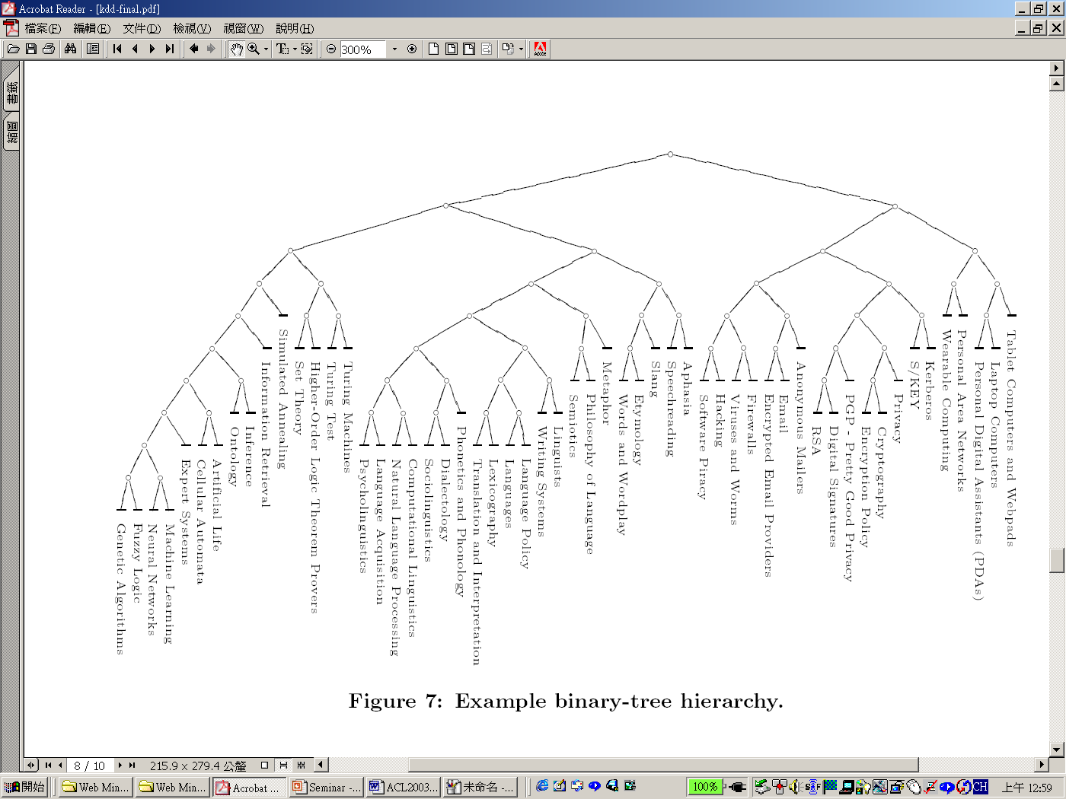
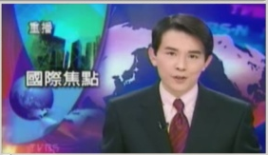
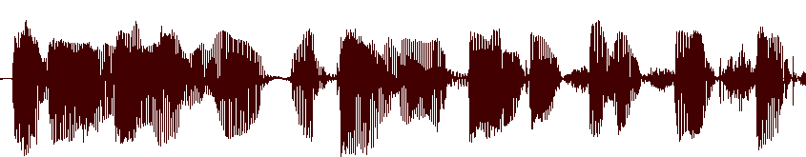
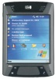
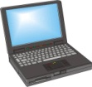


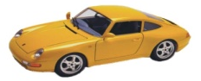
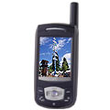
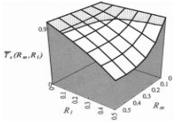



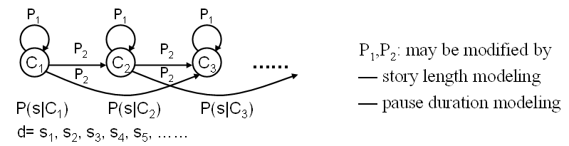

Multimodal Access to Multimedia in the Future
Information Retrieval &
Question Answering
Multimedia
Network
Content
Users
Spoken
Dialogues
Networks
˙
Spoken Document
Recognition,
Distillation & Analysis
Multimodal
Interaction
Multimedia Content
Processing

Slide 5
Related Research Work and Applications
Continuous and substantial efforts have been paid to (multimedia) spoken document recognition, distillation and retrieval in the recent past
  Informedia System at Carnegie Mellon Univ.
  AT&T SCAN System
  Rough’n’Ready System at BBN Technologies
  SpeechBot Audio/Video Search System at HP Labs
  IBM Speech Search for Call-Center Conversations & Call-Routing, Voicemails, Monitoring Global Video and Web News Sources (TALES)
  Google Voice Search (GOOG-411, Audio Indexing, Translation)
  Microsoft Research Audio Video Indexing System (MAVIS)
  MIT Lecture Browser
  NTT Speech Communication Technology for Contact Centers
  Some Prototype Systems Developed in Taiwan

Slide 6
World-wide Speech Research Projects
There also are several research projects conducting on related spoken document processing tasks, e.g.,
  Rich Transcription Project¹ in the United States (2002-)
    Creation of recognition technologies that will produce transcriptions which are more readable by humans and more useful for machines
  TC-STAR Project² (Technology and Corpora for Speech to Speech Translation) in Europe (2004-2007)
    Translation of speeches recorded at European Parliament, between Spanish and English, and of broadcast news by Voice of America, from Mandarin to English
  Spontaneous Speech Corpus and Processing Project in Japan (1999-2004)
    700 hours of lectures, presentations, and news commentaries
    Automatic transcription, analysis (tagging), retrieval and summarization of spoken documents
¹ http://www.nist.gov/speech/tests/rt/
² http://www.tc-star.org

Slide 7
Evaluations of the Rich Transcription Project
GALE (Global Autonomous Language Exploitation) Translation: 2006 – present
  Translates language data from a input source language (either Arabic or Chinese, in audio or text) into a target one (English in text).
Spoken Term Detection: 2006 – present
  Facilitate research and development of technology for finding short word sequences rapidly and accurately in large heterogeneous audio archives (three languages: Arabic, English, and Mandarin)
TRECVid Event Detection: 2008 –
Language Recognition Evaluation: 1996 –
…

Slide 8
Categorization of Spoken Document Search Tasks
Spoken Document Retrieval (SDR)
  Find spoken documents that are (topically) “relevant” to a given query
  Queries usually are very long topic descriptions
  Exploit LVCSR and text IR technologies
  SDR is already regarded as a “solved” problem, especially for broadcast news (even with WER of more than 30%, retrieval using automatic transcripts are comparable to that using reference transcripts)
Spoken Term Detection (STD)
  Much like Web-style search
  Queries are usually short (1-3 words), and find the “matched” documents where all query terms should be present
  Then, relevance ranking are performed on the “matched” documents
  Have drawn much attention recently in the speech processing community
    Exploit word lattices or confusion networks consisting of multiple hypotheses to compensate for speech recognition errors

Slide 9
TREC SDR Evaluation Plan
A series of SDR tracks conducted during 1996-2000 (TREC-6 ~ TREC-9)
  Focus on using broadcast news from various sources: Voice of America, CNN, ABC, PRI, etc., comprising more than 5 hundred hours of speech (≧20,000 manually segmented documents, 250 words per document on average)
  The queries are long and stated in plain English (e.g., a text news story) rather then using the keyword (Web) search scenario
Findings
  Retrieval performance is quite flat with ASR WER variations in the range of 10~35% (roughly ≦5% degradation in performance in comparison with the “approximately” manual transcriptions)
  SDR of broadcast news speech has been thought of as “a successful story”
J.S. Garofolo, et al., “The TREC spoken document retrieval track: A success story,”
http://trec.nist.gov/pubs/trec8/./papers/trec8-sdr-overview.ps

Slide 10
Types of ASR Transcriptions (1/2)
Word Sequences Produced by LVCSR
  More accurate for audio indexing
  Faced with the “OOV-word” problems (query terms are often less-frequent topic-specific words)
  Tend to have lower recall
Phonetic-Unit (or subword) Sequences Produced by Phone Recognizer
  Bypass the “OOV-word” problems by locating spoken documents containing the phonetic sequences that match the pronunciations of the query words
  Complicate the post-processing of the spoken documents for other IR-related applications
  Tend to have higher recall at the expanse of lower precision
Hybrid Approach Blending Word and Phonetic Information

Slide 11
Types of ASR Transcriptions (2/2)
Represent the OOV region by a network of phonetic units
p₁
p_{m}
P(OOV)
w₁
1-P(OOV)
w_{n}

Slide 12
Evaluation Metrics
SDR and STD
  Recall
  Precision
  F-measure (a harmonic mean of recall and precision)
  R-precision
  Precision at N document cutoff level
  Mean Average Precision (MAP)
  Actual Term-Weighted Value (ATWV)
  …
ASR
  WER
  Lattice WER
  OOV Rate
  Query OOV Rate
  …

Slide 13
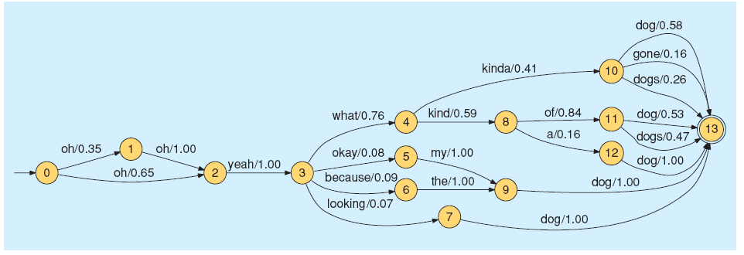
STD: 1-bset Sequences vs. Lattices (1/5)
Use of 1-best ASR output as the transcription to be indexed is suboptimal due to the high WER, which is likely to lead to low recall
ASR lattices do provide much better WER, but the position information is not readily available (uncertainty of word occurrences) ?
An example ASR Lattice
Adapted from: C. Chelba, T.J. Hazen, and M. Saraclar, “Retrieval and browsing of spoken content,”
IEEE Signal Processing Magazine 25 (3), May 2008
Notes:
Lattice: its easy to evaluate whether two words are adjacent but much harder to determine whether two query words co-occur within a window of K words

Slide 14
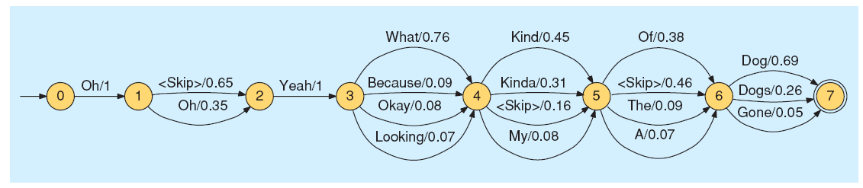
STD: 1-bset Sequences vs. Lattices (2/5)
Confusion/Consensus Networks (CN, also called “Sausages”) derived from the Lattice
  Group the word arcs in the lattice into several strictly linear lists (clusters) of word alternatives
  L. Mangu, E. Brill, A. Stolcke, “Finding consensus in speech recognition: word error minimization and other applications of confusion networks,” Computer Speech & Language 14(4), 2000
Adapted from: C. Chelba, T.J. Hazen, and M. Saraclar, “Retrieval and browsing of spoken content,”
IEEE Signal Processing Magazine 25 (3), May 2008

Slide 15
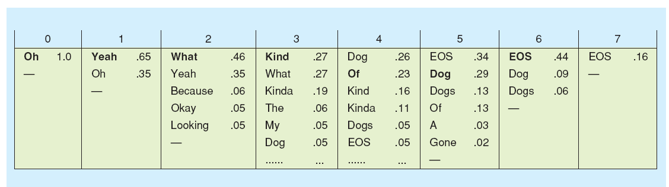
STD: 1-bset Sequences vs. Lattices (3/5)
Position-Specific Posterior Probability Lattices (PSPL)
  Position information is crucial for being able to evaluate proximity when assigning a relevance score to a given document
  Estimate the posterior probability of a word at a specific position in the lattices of spoken query and documents
  Technical Details of PSPL
Adapted from: C. Chelba, T.J. Hazen, and M. Saraclar, “Retrieval and browsing of spoken content,”
IEEE Signal Processing Magazine 25 (3), May 2008

Slide 16
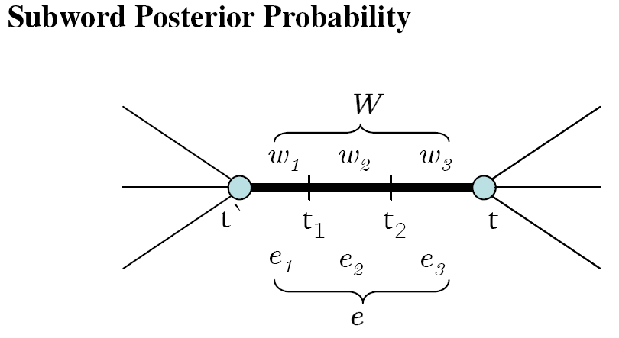
STD: 1-bset Sequences vs. Lattices (4/5)
Y.C. Pan and L.S. Lee at NTU extend PSPL to indexing subword-level (character & syllable) information for retrieval of Chinese broadcast news (using text queries)
  “Analytical comparison between position specific posterior lattices and confusion network based on word and subword
  units for spoken document indexing,” ASRU 2007
P. Yu, F. Seide et al. at MSRA proposed alternative approaches that are analogous to PSPL
  Time-based Merging for Indexing (TMI) for size reduction and Time-Anchored Lattice Expansion (TALE) for word-position mapping
  “Word-lattice based spoken-document indexing with stand text indexers,” SSCS 2008 (in conjunction with SIGIR 2008) & SLT2008

Slide 17
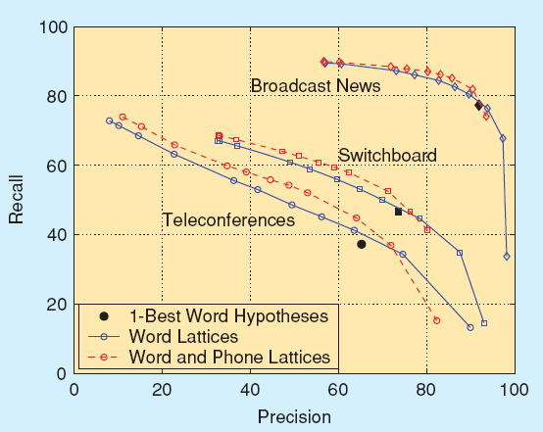
STD: 1-bset Sequences vs. Lattices (5/5)
Comparison between indexing with 1-bset sequences and lattices
Adapted from: C. Chelba, T.J. Hazen, and M. Saraclar, “Retrieval and browsing of spoken content,”
IEEE Signal Processing Magazine 25 (3), May 2008

Slide 18
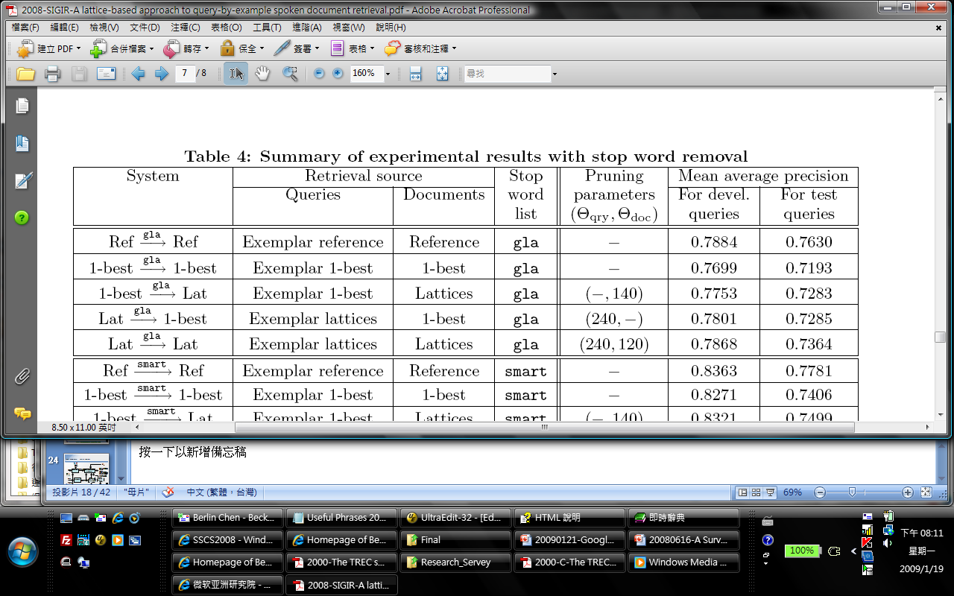
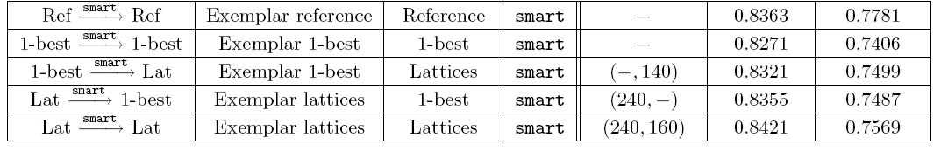
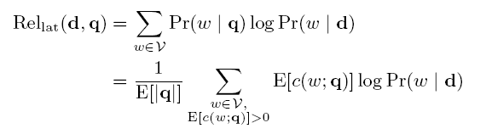
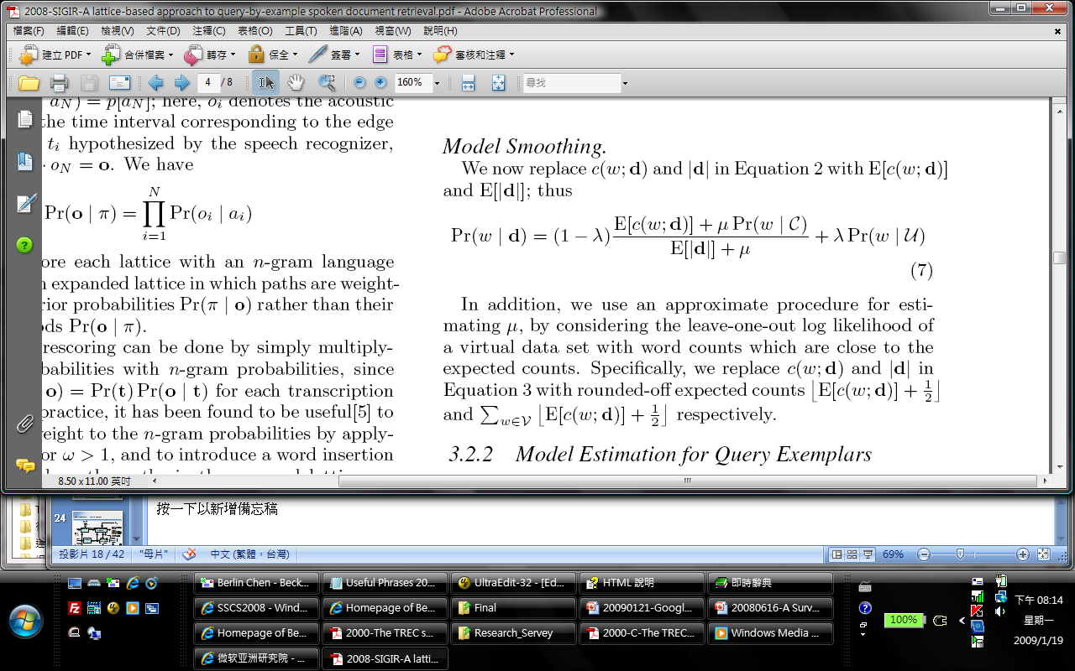
SDR: Exploiting Lattices and Language Models
T.K. Chia, H. Li, H.T. Ng et al., extended Chen et al.’s work on query-by-example (ACM TALIP 2004) to spoken queries, and also extended Lafferty and Zhai’s Kullback-Leibler divergence based LMs for document modeling (SIGIR 2001)
  “A lattice-based approach to query-by-example spoken document retrieval,” SIGIR 2008

Slide 19
SDR: Word Topic Models (1/4)
Each word of a language is treated as a word topic model (WTM) for predicting the occurrences of other words
The relevance measure between a query and a document can be expressed by
  - B. Chen, “Word topic models for spoken document retrieval and transcription,” ACM TALIP, March 2009
  - B. Chen, “Latent topic modeling of word co-occurrence information for spoken document retrieval,” IEEE ICASSP2009

Slide 20
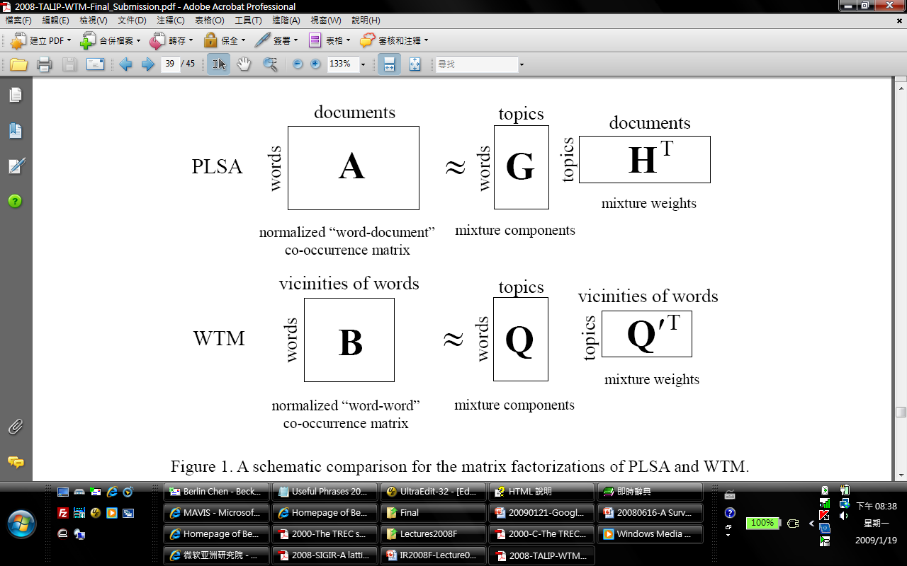
SDR: Word Topic Models (2/4)
WTM also can be viewed as a nonnegative factorization of a “word-word” matrix consisting probability entries (for unsupervised model training)
  Each column encodes the vicinity information of all occurrences of a distinct word
PLSA/LDA
WTMM

Slide 21
SDR: Word Topic Models (3/4)
Unsupervised training (WTM-U)
  The WTM of each word can be trained by concatenating those words occurring within a context window of size around each occurrence of the word, which are postulated to be relevant to the word
Supervised training (WTM-S)
  Maximize the log-likelihood of a set of training query exemplars generated by their relevant documents

Slide 22
SDR: Word Topic Models (4/4)
Tested on TDT-2 & TDT-3 Collections
WTM also have been applied with good success to speech recognition and speech summarization
  “Word topical mixture models for dynamic language model adaptation,” ICASSP 2007
  “Word Topical Mixture Models for Extractive Spoken Document Summarization,” ICME 2007
Retrieval Model | VSM | LSA | SVM | HMM/ Unigram | HMM/ Bigram | PLSA-U | PLSA-S | WTM-U | WTM-S
TD | 0.5548 | 0.5510 | 0.5797 | 0.6327 | 0.5427 | 0.6277 | 0.7243 | 0.6395 | 0.7672
SD | 0.5122 | 0.5310 | 0.5317 | 0.5658 | 0.4803 | 0.5681 | 0.6652 | 0.5739 | 0.7558

Slide 23
History of Text Summarization Research
Research into automatic summarization of text documents dates back to the early1950s
  However, research work has suffered from a lack of funding for nearly four decades
Fortunately, the development of the World Wide Web led to a renaissance of the field
  Summarization was subsequently extended to cover a wider range of tasks, including multi-document, multi-lingual, and multi-media summarization

Slide 24
Spectrum of Text/Speech Summarization Research (1/2)
Extractive and Abstractive Summarization
  Extractive summarization produces a summary by selecting indicative sentences, passages, or paragraphs from an original document according to a predefined target summarization ratio
  Abstractive summarization provides a fluent and concise abstract of a certain length that reflects the key concepts of the document
    This requires highly sophisticated techniques, including semantic representation and inference, as well as natural language generation
  In recent years, researchers have tended to focus on extractive summarization.

Slide 25
Spectrum of Text Summarization Research (2/2)
Generic and Query-oriented Summarization
  A generic summary highlights the most salient information in a document
  A query-oriented summary presents the information in a document that is most relevant to the user’s query
Query: Obama elected president
retrieved documents
with time stamps
Doc 1
time stamps
Doc 2
Doc 100
N-word summary

Slide 26
A Probabilistic Generative Framework for Speech Summarization (1/2)
Criterion: Ranking sentences by their posteriori probabilities
Sentence Generative Model,
  Each sentence of the document as a probabilistic generative model
  Language Model (LM), Sentence Topic Model (STM) and Word Topic Model (WTM) are initially investigated
Sentence Prior Distribution,
  The sentence prior distribution may have to do with sentence duration/position, correctness of sentence boundary, confidence score, prosodic information, etc.
Chen et al., “A probabilistic generative framework for extractive broadcast news speech
summarization,” IEEE Transactions on Audio, Speech and Language Processing 17(1), 2009

Slide 27
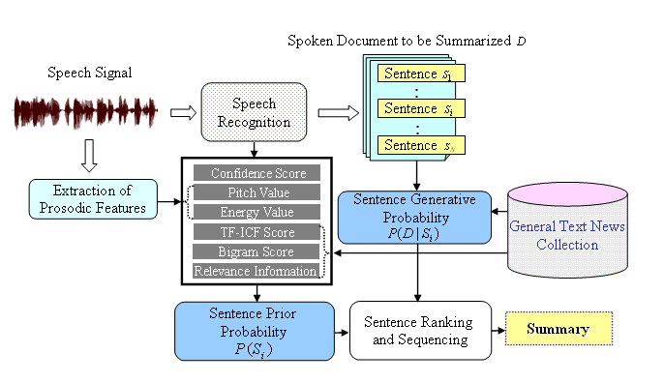
A Probabilistic Generative Framework for Speech Summarization (2/2)
Speech summarization can be performed in a purely unsupervised manner
Chen et al., “A probabilistic generative framework for extractive broadcast news speech
summarization,” IEEE Transactions on Audio, Speech and Language Processing 17(1), 2009

Slide 28
Features Can be Used for Speech Summarization
Structural Features (St) | POSITION: Sentence position DURATION: Duration of the preceding/current/following sentence
Lexical Features (Le) | BIGRAM_SCORE: Normalized bigram language model scores SIMILARITY: Similarity scores between a sentence and its preceding/following neighbor sentence NUM_NAME_ENTITIES: Number of named entities (NEs) in a sentence
Acoustic Features (Ac) | PITCH: Min/max/mean/difference pitch values of a spoken sentence ENERGY: Min/max/mean/difference value of energy features of a spoken sentence CONFIDENCE: Posterior probabilities
Relevance Features (Re) | R-VSM: Relevance score obtained by using the VSM summarizer R-LSA: Relevance score obtained by using the LSA summarizer
Lin et al., “A comparative study of probabilistic ranking models for Chinese spoken document summarization,” ACM Transactions on Asian Language Information Processing, March 2009

Slide 29
Discussions
The use of word lattices (PSPL ,CN, et al.) has been an active area of research for robust audio indexing and retrieval
Most of the research efforts devoted to spoken document retrieval focus on “text” queries but not “spoken” queries
Given a query stating the user’s information need
  Which will be preferable ? Finding “matched” spoken terms in documents or retrieving “relevant” documents
Word topic models (WTM) has shown with good potential for spoken document recognition, search and summarization

Slide 30
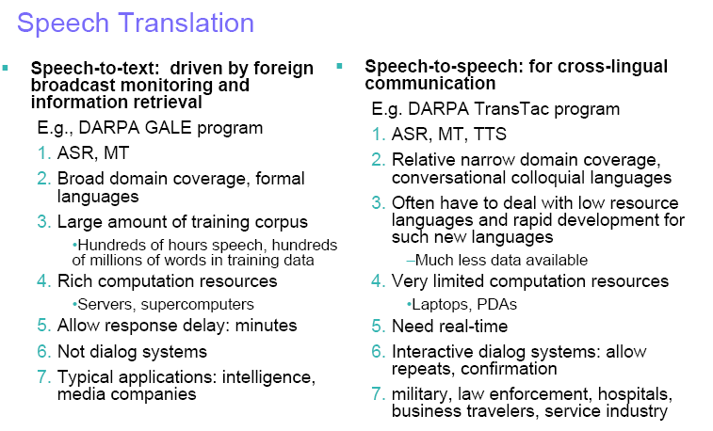
IBM’s Research Activities in Speech Translation and Speech-based Multimedia Content Access
IBM TALES
project
IBM MASTOR
project
Adapted from the presentation slides of Dr. Yuqing Gao’s at ISCSLP2008

Slide 31
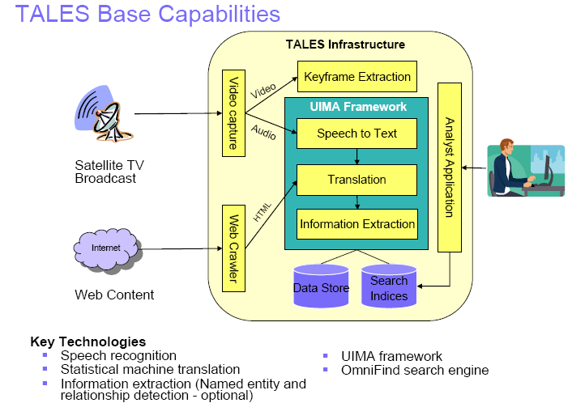
IBM TALES (Translingual Automatic Language Exploitation System) Project (1/2)
TALES is a IBM solution for English
speakers for global news
monitoring for Arabic, Chinese,
Farsi, Spanish, and English video and web news sources.
http://domino.research.ibm.com/comm/research_projects.nsf/pages/tales.index.html
Adapted from the presentation slides of Dr. Yuqing Gao’s at ISCSLP2008

Slide 32
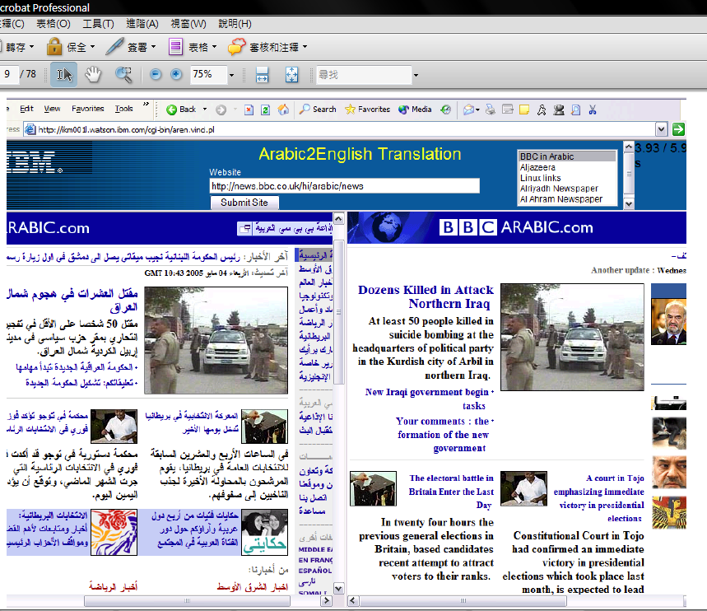
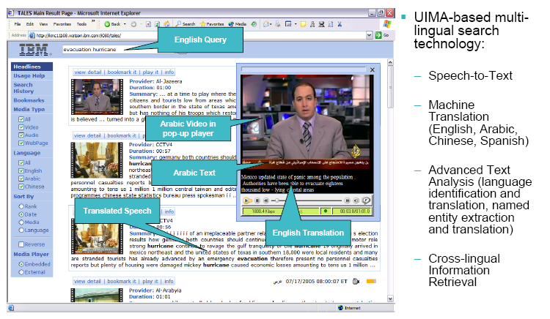
IBM TALES (Translingual Automatic Language Exploitation System) Project (2/2)
TALES Demo
Foreign Web Site Translation and Search
Foreign Broadcast Video Monitoring and Search
Adapted from the presentation slides of Dr. Yuqing Gao’s at ISCSLP2008

Slide 33
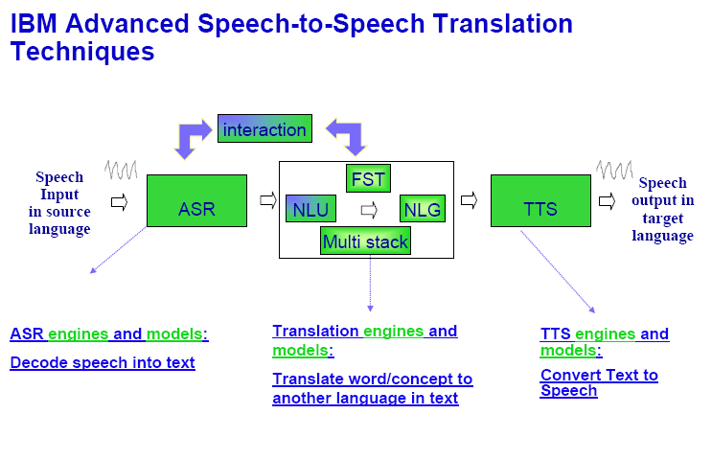
IBM Mastor (Speech-to-Speech Translation) Project (1/2)
MASTOR is a two-way, free form speech translator that assists human communication using natural spoken language for people who do not share a common language
http://domino.research.ibm.com/comm/research_projects.nsf/pages/mastor.index.html
Adapted from the presentation slides of Dr. Yuqing Gao’s at ISCSLP2008

Slide 34
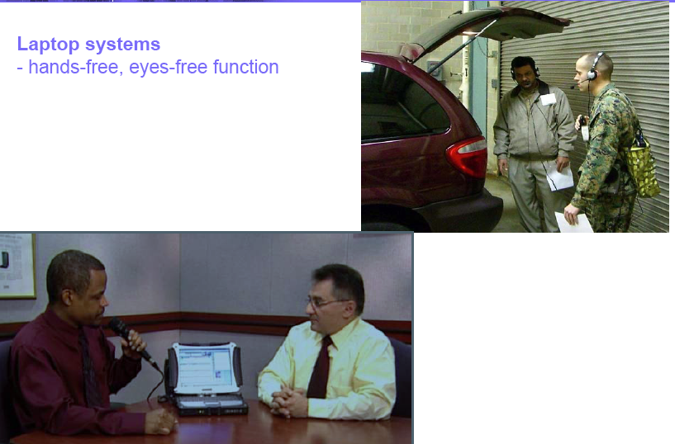
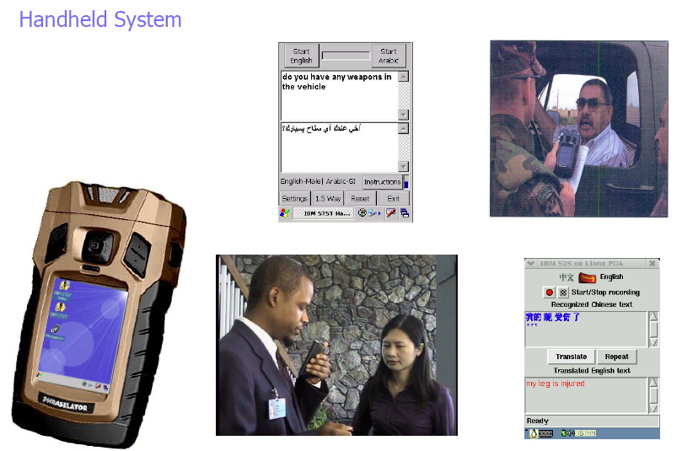
IBM Mastor (Speech-to-Speech Translation) Project (2/2)
MASTOR Demo
Adapted from the presentation slides of Dr. Yuqing Gao’s at ISCSLP2008

Slide 35
IBM’s Audio-Visual Search Solutions
User preferences
Editor
Delivered media is a
personalized build from
+Audio
+Video
+Closed captions
+Slideshow (video-based)
+images of PPT slides
+TTS of PPT slides
+ Audio speedup
+Summarization
ViaScribe
Time-aligned
Transcript, slides
Personalized Views
Producer
Speech
CueVideo
Automatic
Slides-to-video
synchronization
Text to
Speech
Video
Time-aligned
Key-frames
PPT file
(optional)
Adapted from the presentation slides of Dr. Basson et al.

Slide 36
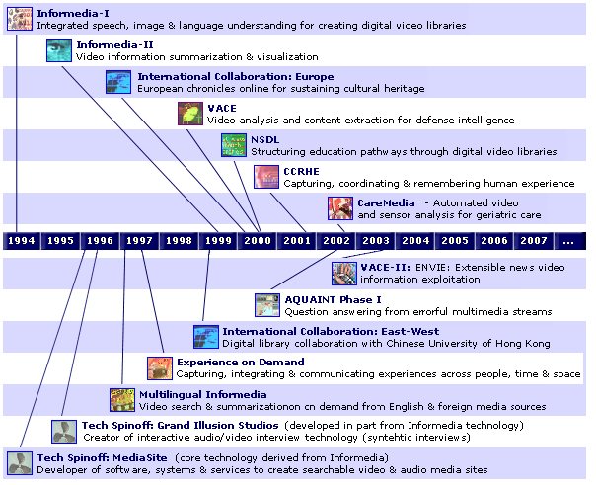
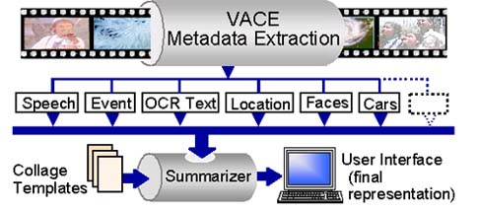
The Informedia System at CMU
Video Analysis and Content Extraction (VACE)
  http://www.informedia.cs.cmu.edu/

Slide 37
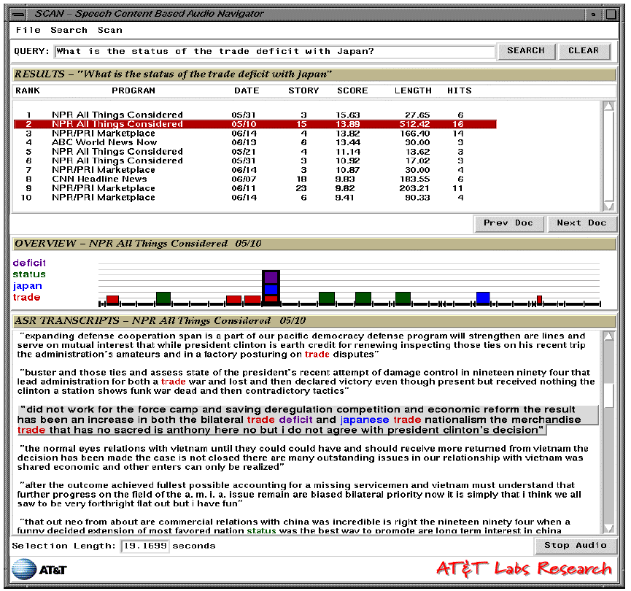
AT&T SCAN System
Design and evaluate user
interfaces to support retrieval
from speech archives
Julia Hirschberg,Fernando Pereira, Amit Singhal et al., “SCAN: designing and evaluating user interfaces to support retrieval from speech archives,” SIGIR 1999

Slide 38
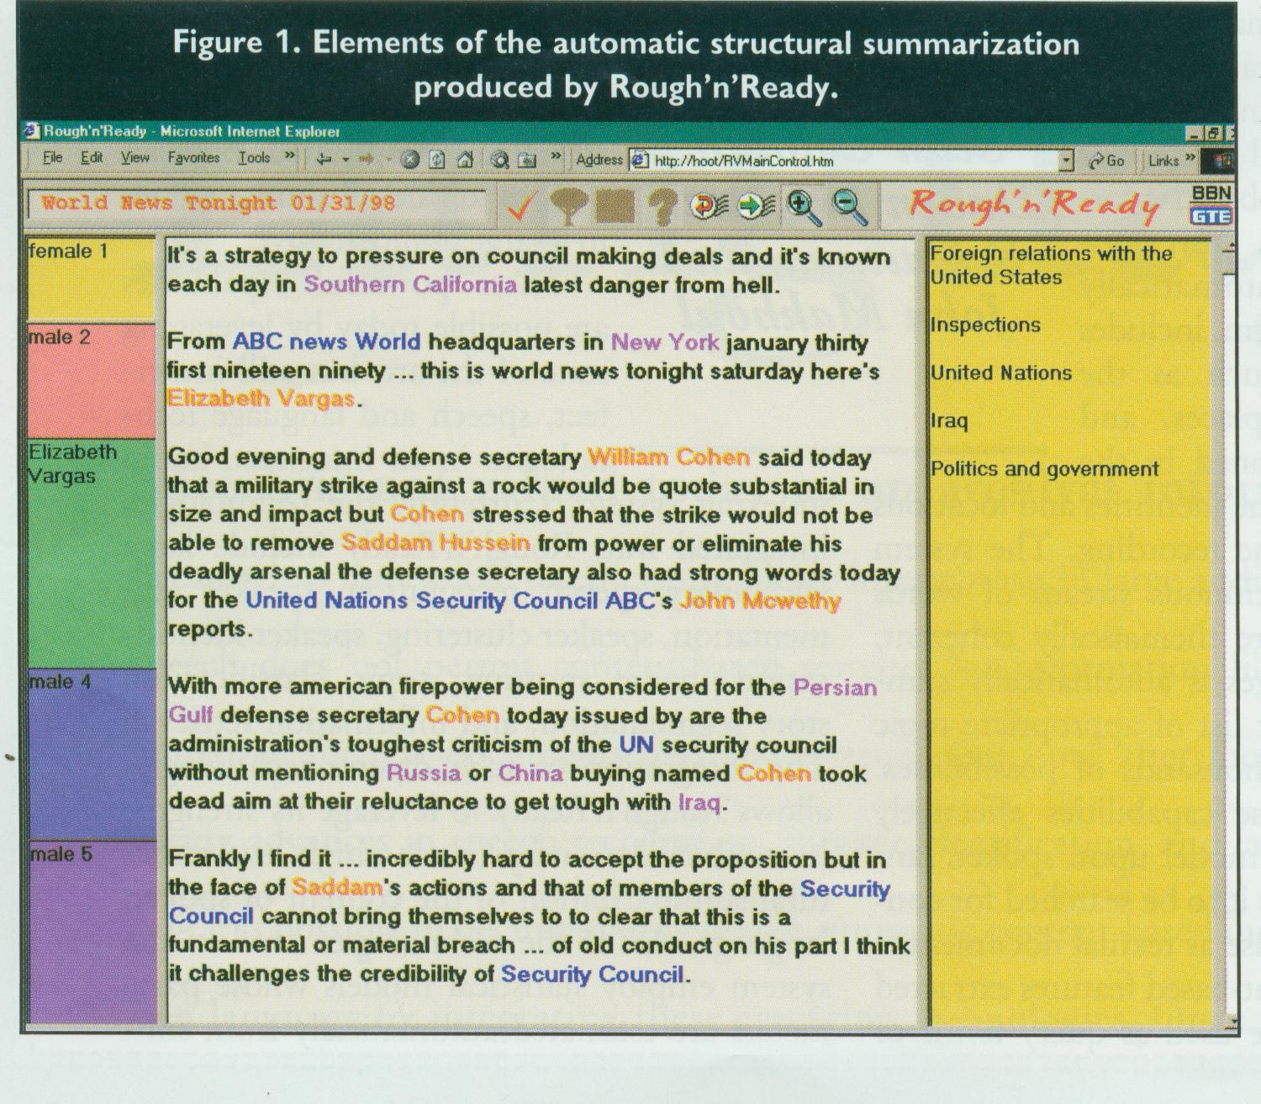
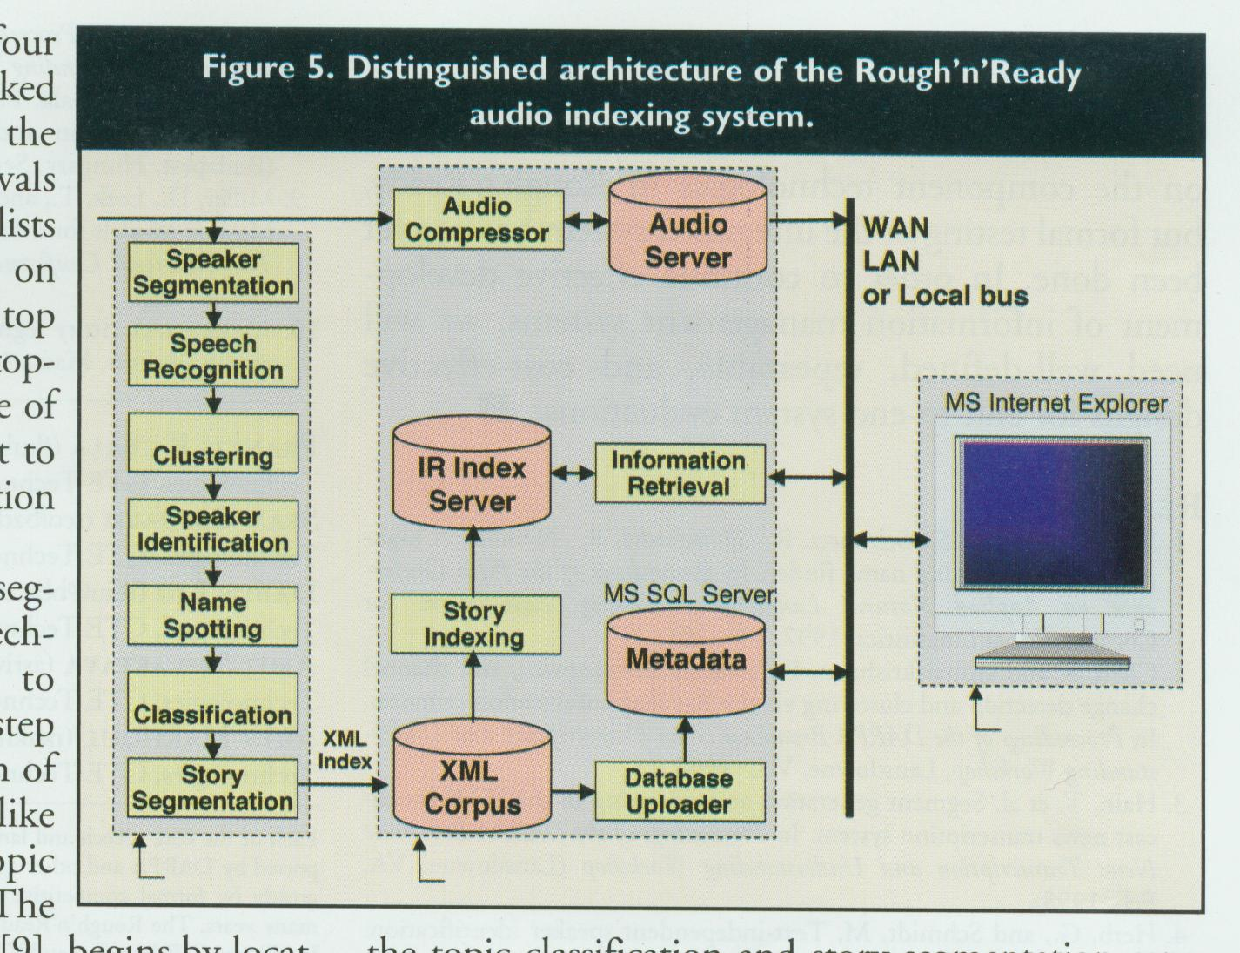
BBN Rough’n’Ready System
Automatic Structural Summarization
for Broadcast News
Distinguished Architecture for Audio
Indexing and Retrieval
John Makhoul et al., “Integrated technologies for indexing spoken language,” Communications of the ACM, 2000

Slide 39
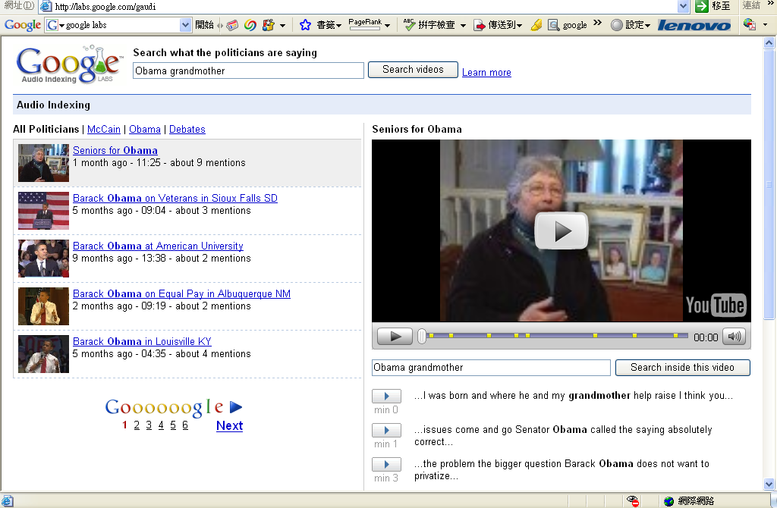
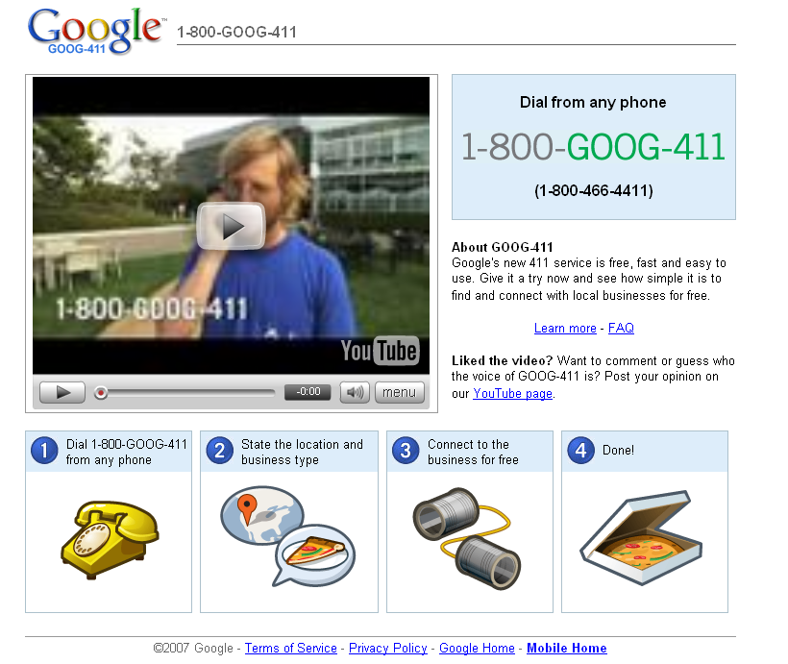
Google Voice Search
Google Audio Indexing:
Searching what people are saying inside YouTube videos (currently only for what the politicians are saying)
Google Voice Local Search
http://labs.google.com/

Slide 40
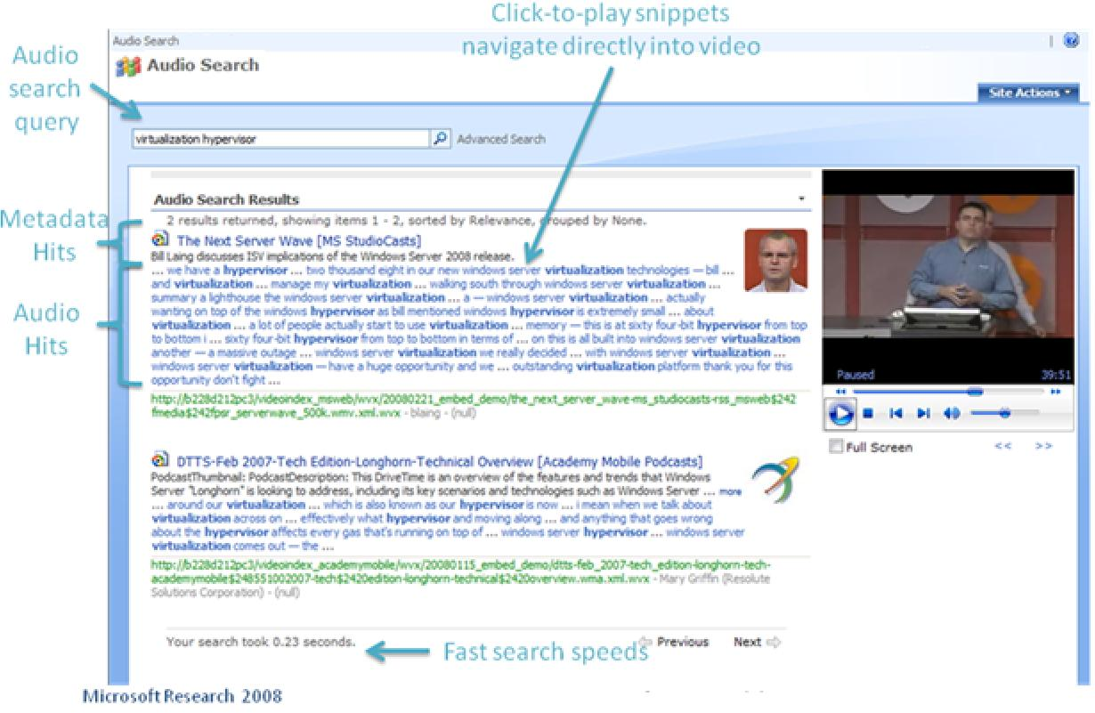
Microsoft Research Audio Video Indexing System (MAVIS)
MAVIS uses speech recognition technology to index spoken content of recorded conversations, like meetings, conference calls, voice mails, lectures, Internet videos
http://research.microsoft.com/en-us/projects/mavis/

Slide 41
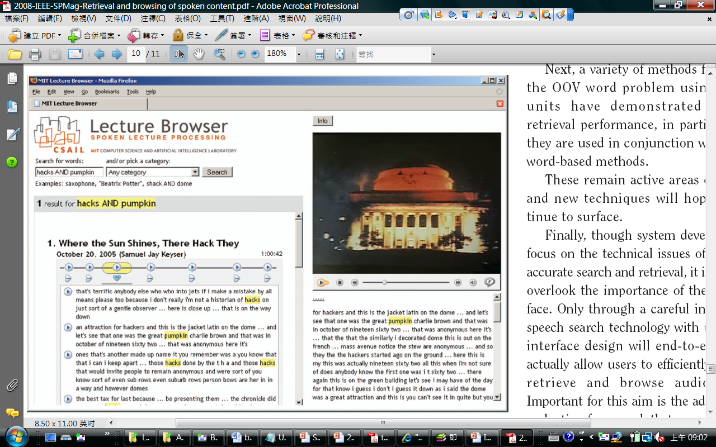
MIT Lecture Browser
Retrieval and browsing of academic lectures of various categories
http://web.sls.csail.mit.edu/lectures

Slide 42
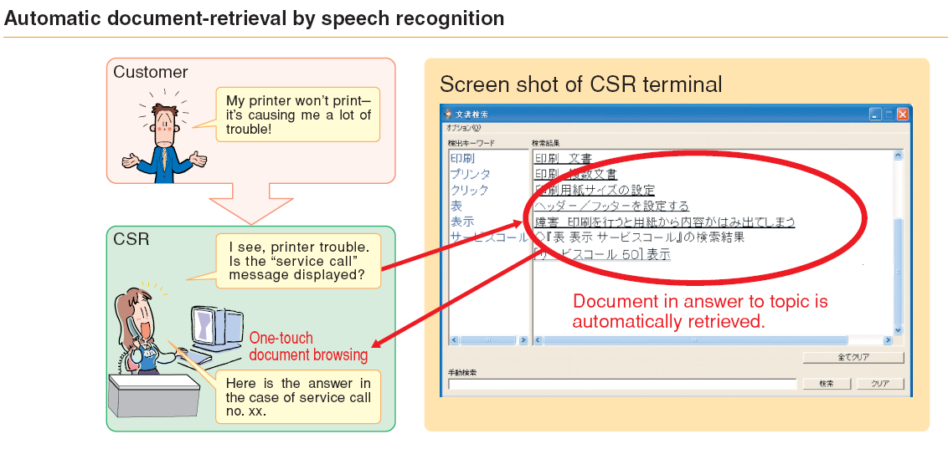
NTT Speech Communication Technology for Contact Centers
  CSR: Customer Service Representative

Slide 43
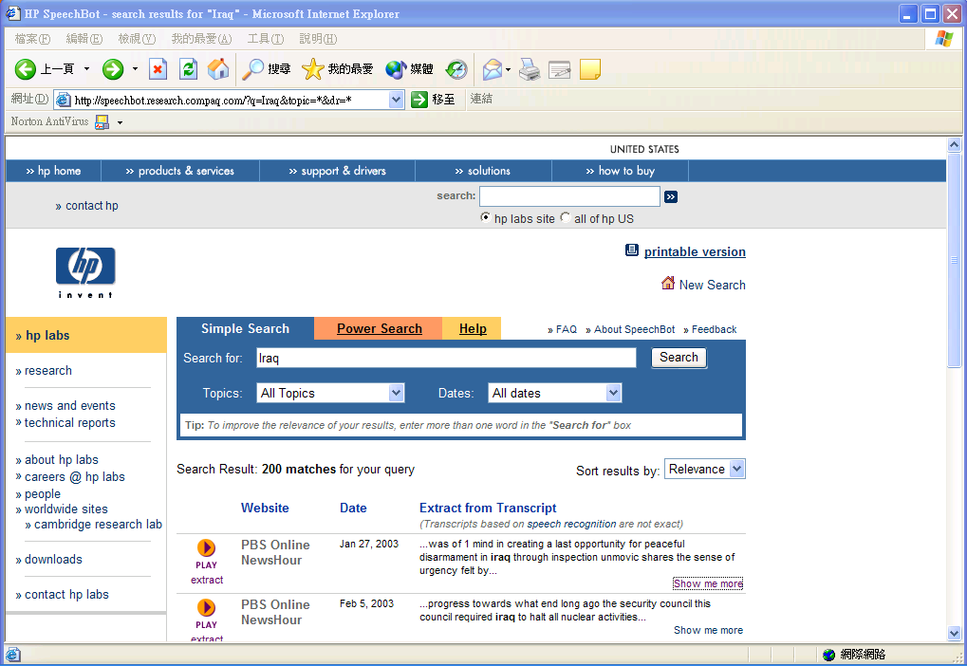
SpeechBot Audio/Video Search System at HP Labs
An experimental Web-based tool from HP Labs that used voice-recognition to create seachable keyword transcripts from thousands of hours of audio content

Slide 44
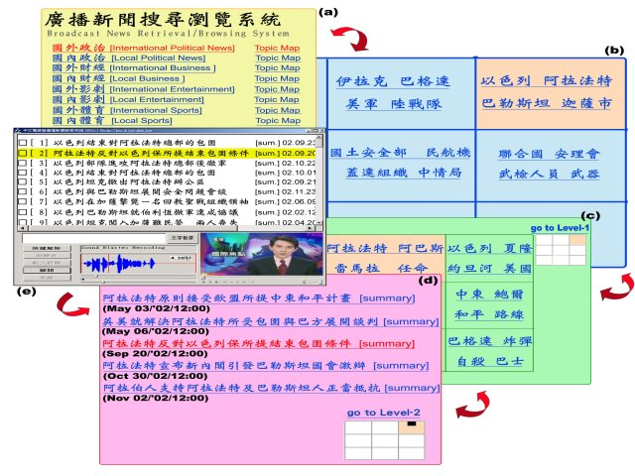
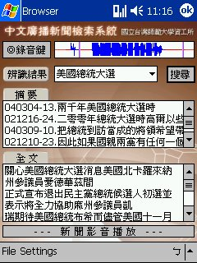
Some Prototype Systems Developed in Taiwan
NTU Broadcast News Retrieval and Browsing System (Prof. Lin-shan Leee), 2004~
NTNU PDA Broadcast News Retrieval System (Dr. Berlin Chen), 2003~2004
Lin-shan Lee and Berlin Chen, “Spoken document understanding and organization,” IEEE Signal Processing Magazine, 2005.

Slide 45
Appendix A: Actual Term Weighted Value (2/2)
Actual Term Weighted Value (ATWV) is a metric defined in the NIST Spoken Detection (STD) 2006 evaluation plan

Slide 46
Appendix A: Mean Average Precision (mAP) (1/2)
Average Precision at Seen Relevant Documents
  A single value summary of the ranking by averaging the precision figures obtained after each new relevant doc is observed
  It favors systems which retrieve relevant docs quickly (early in
  the ranking)
  But when doc cutoff levels were used
    An algorithm might present a good average precision at seen relevant docs but have a poor performance in terms of overall recall
(P=0.5)
1. d₁₂₃ • 6. d₉ • 11. d₃₈
2. d₈₄ 7. d₅₁₁ 12. d₄₈
3. d₅₆ • 8. d₁₂₉ 13. d₂₅₀
4. d₆ 9. d₁₈₇ 14. d₁₁₃
5. d₈ 10. d₂₅ • 15. d₃ •
(P=1.0)
(P=0.66)
(P=0.4)
(P=0.3)
(1.0+0.66+0.5+0.4+0.3)/5=0.57
alg1
alg2
Cutoff

Slide 47
Appendix A: Mean Average Precision (mAP) (2/2)
Averaged at relevant docs and across queries
  E.g. relevant docs ranked at 1, 5, 10, precisions
  are 1/1, 2/5, 3/10,
    non-interpolated average precision (or called Average Precision at Seen Relevant Documents in textbook) =(1/1+2/5+3/10)/3
  Mean average Precision (mAP)
Widely used in IR performance evaluation

Slide 48
Appendix A: Word Error Rate (WER) (2/2)
The speech recognition experiments are usually evaluated in terms of word error rate (WER)
  Defined by the sum of the insertion (Ins), deletion (Del), and substitution (Sub) errors between the recognized and reference word strings, divided by the total number of words in the reference string (Ref)

Slide 49
Position-Specific Posterior Probability Lattices (1/6)
Soft-hit: indexing of the occurrence of each word n in the lattice
A modified forward procedure
position/length along the
partial path traversed
insertion penalty
C. Chelba, J. Silva and A. Acero, “Soft indexing of speech content for search in spoken documents,”
Computer Speech & Language 21(3), 2007

Slide 50
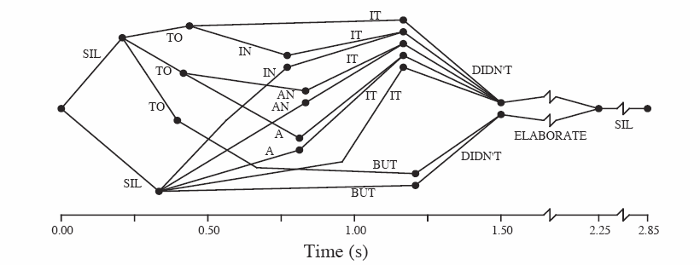
Position-Specific Posterior Probability Lattices (2/6)
The backward procedure follows the original definition
The posterior probability for a word w at position l is expressed as (i.e., expected counts of w at position l)

Slide 51
Position-Specific Posterior Probability Lattices (3/6)
A document D can be first divided into several segments
Then, calculate the expected count of a given query term according to the PSPL probability distribution for each segment s of document D
Query
unigram
matching
N-gram
(or phrase)
matching

Slide 52
Position-Specific Posterior Probability Lattices (4/6)
“Relative Pruning” of PSPL lattices
  For a given position bin l, the relative pruning first finds the most likely word entry given by
  Word entries have test values lower than or equal to the threshold are retained in the position bin of the PSPL lattice
    As the threshold decreased to zero, the pruned PSPL is reduced “approximately” to the 1-best output
    Then,the posterior probability of words (bin entries) in each bin are renormalized

Slide 53
Position-Specific Posterior Probability Lattices (5/6)
“Absolute Pruning” of PSPL lattices
  Retrain the word entries in each bin l that have log posterior probability higher than an absolute threshold
“Absolute Pruning” can be performed at query run-time

Slide 54
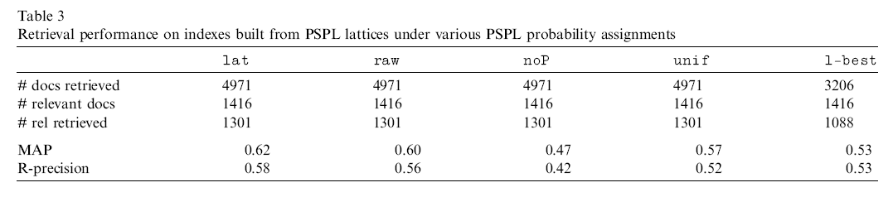
Position-Specific Posterior Probability Lattices (6/6)
Corpus: MIT iCampus Corpus (169 h, recorded using lapel microphone)
  116 test text queries (Q-OOV rate: 5.2%; avg. query length: 1.97 words)
Experiments on various PSPL probability assignments
without flattening of
word prob.
without using posterior prob.
(hard-index, more than one word occurs at the same position)
Uniform posterior prob.
1.0/#entries in each position

